Slide 1
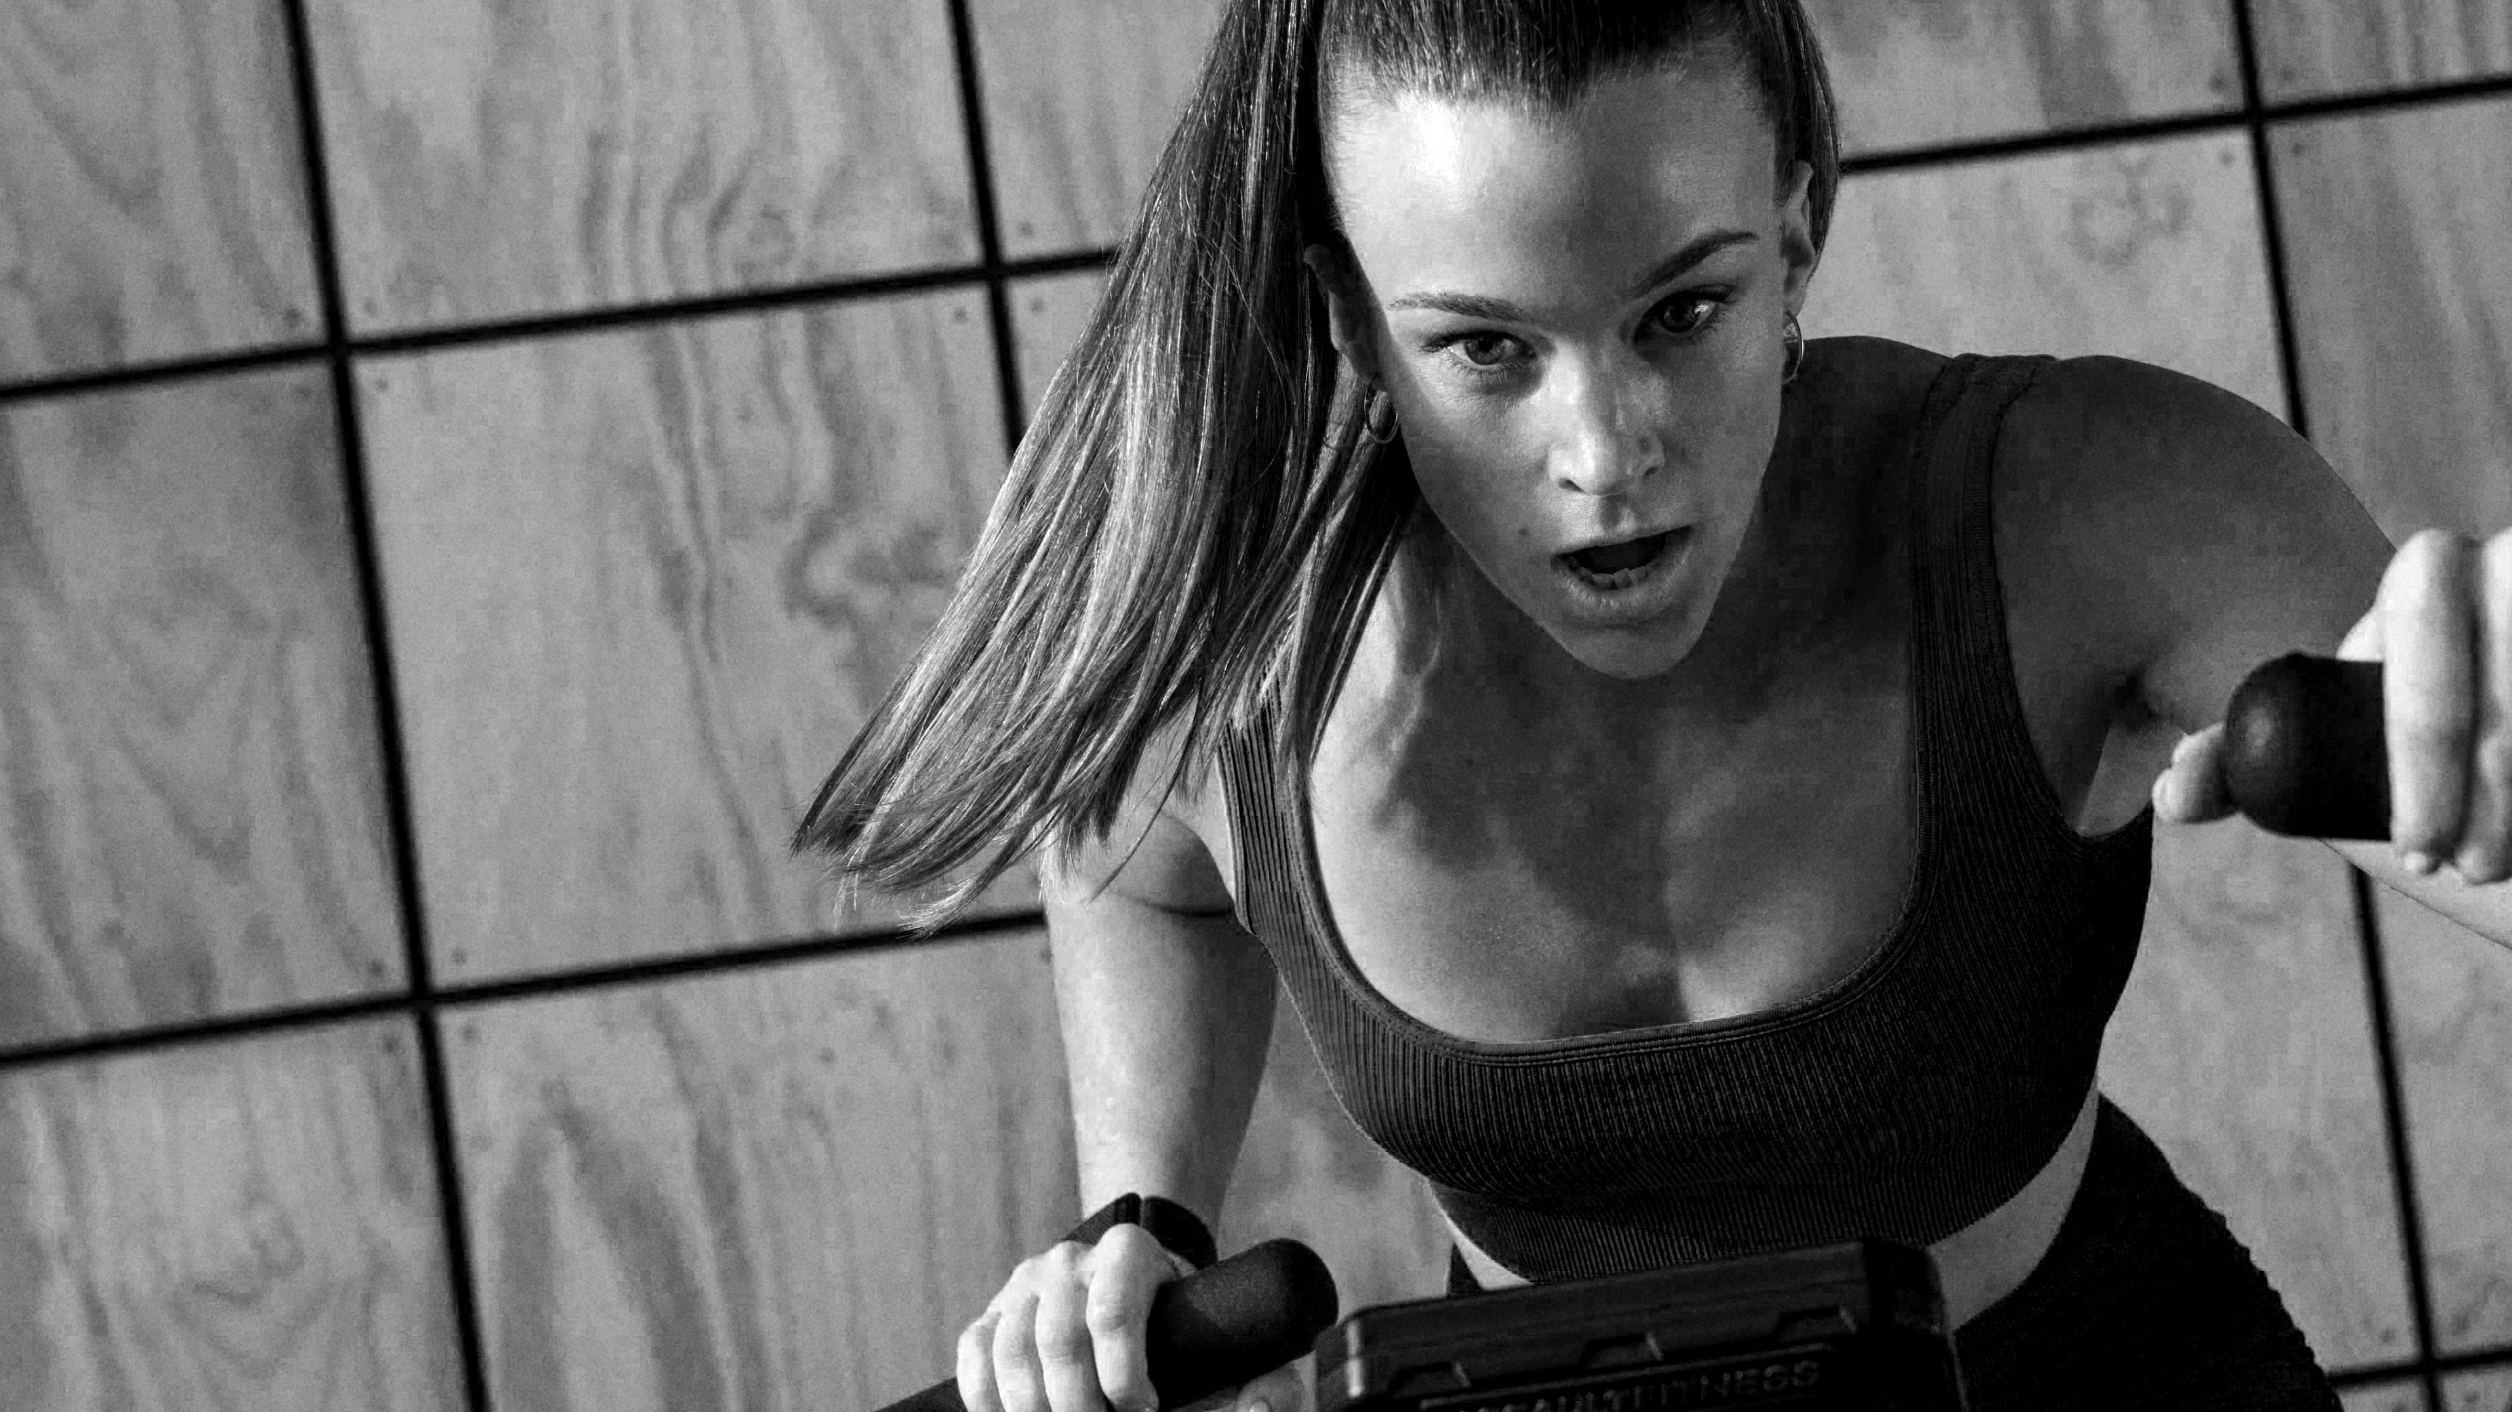

STRONG
OPERATING MODEL

Slide 2

STRONG
OUR PEOPLE
OUR SERVICE
OUR PRODUCT
OUR MEMBERS
OUR PROCESS
OUR EXPERIENCE

Slide 3
AGENDA
Day 1
Membership tour and closing
Club walkthrough
Cancellations
R&C processes
Day 2
DEMOTU
GP3 Overview
CPTS
PT business

Slide 4
OUR SERVICE: NEW MEMBER ONBOARDING
CONSIDERATIONS
Emphasis in creating a consistent member & team member experience
Tours focus concentration surrounding fitness education & building value
Concentration is on guest’s needs and ultimately helping to change their lives
Separate ourselves from the competition by doing it better
Our Objective is to create a formalized sales process that establishes a strong service culture, while creating a world class experience for our new members.

Slide 5
OUR SERVICE: NEW MEMBER ONBOARDING
NOT REINVENTING THE WHEEL…KEEPING IT SIMPLE
How we do that...
Easy 5-step process
Builds a cadence and business rhythm
Easy and scalable across all clubs…what we know works!
STEP 1
STEP 2
STEP 3
STEP 4
STEP 5
GREETING
DISCOVERY
TOUR
CLOSE
APOS/POST CLOSE
SET
CONDUCT

Slide 6
OUR SERVICE: GREETING
Our objective is to establish a standard for new member onboarding and tours that align with our operational excellence mantra on hospitality.
STARTS WITH OUR FRONT DESK…
FDA Welcome Expectations:
Smile, say hello, introduce yourself
Ask how we can help them today
First Impressions: be proud to work at Gold’s Gym; bring energy and enthusiasm
GUEST BY GUEST/KIOSK MANAGEMENT:
Every guest should meet a manager
Every guest should be offered a tour
If manager is not available, every FDA should assist the guest with pricing options at the kiosk
A CPTS should be offered/booked with every new member
Notes:
Hopefully different picture from creative; don’t love this one

Slide 7
OUR SERVICE: TRANSITION TO TOUR
It is important to remember that most guests do not know much about our club or how we operate. Every step of their journey should be supported and guided by our team.
How we do that
Every guest gets a red-carpet experience provided by management.
We use a 5-step process to seamlessly transition them to the manager.
STEP 1
STEP 2
Introduce to the manager
Greeting Process
Direct guest
to kiosk
Inform guest that a manager will assist them
STEP 5
Understand the guests needs
STEP 3
STEP 4
*Only in the event that the manager is unavailable, front desk team member should schedule CPTS.

Slide 8
OUR SERVICE: TRANSITION STEPS
GREETING PROCESS
Understand the guests needs
Direct guest to kiosk
Inform guest that a manager will assist them
Get the manager
This is the same process we use to greet our members.
Acknowledge them entering.
Welcome them to the gym.
Ask how we can help them.
Ask if they have ever been here before.
Introduce yourself
Ask them to complete our guest check-in so we can show them around the gym.
Show them how to complete the waiver.
Let them know that while they complete the waiver, we will get a manager to show them around and answer any questions they may have.
Inform the manager there is a guest wanting to see the gym.
Give the manager the members name.
Introduce the manager to the guest.

Slide 9
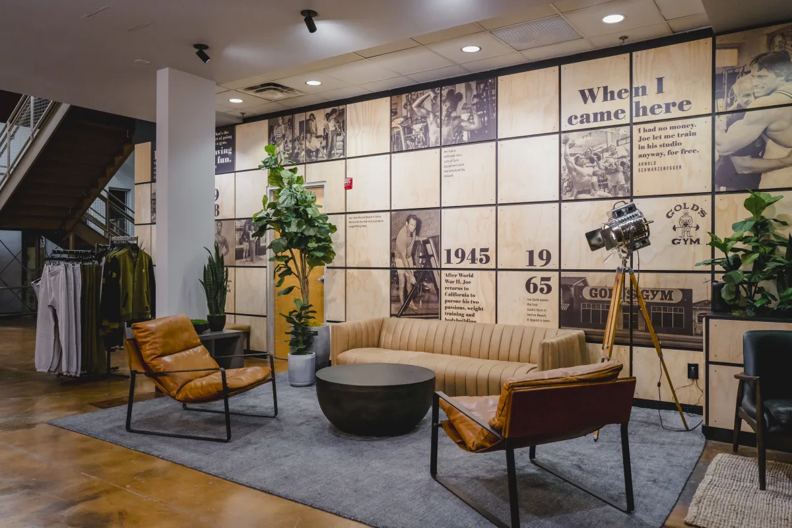
OUR SERVICE: DISCOVERY AND QUALIFICATION
PURPOSE OF DISCOVERY...
Our goal is to determine:
What are their “emotional drivers” behind coming into the gym today?
What are the opportunities we have to serve them?
Uncover guests wants/needs
This is where extreme value is built
Understanding a Guest’s goals, along with what the success factors indicate, allows us to shape the focus of our tour and recommendation

Slide 10
OUR SERVICE: BUILDING RAPPORT
Our objective is to establish warmth, trust, enthusiasm/excitement with guest. ​
​
Considerations ​
Gauge the temperature of a guest ​
Are they excited? Do they have time? Are they in a rush?​
Most are intimidated by the gym or the process​
We want them to have a relaxed and fun experience​
​
Discovery/Qualification​
Best if we can sit down to GTKY​
Small table by FD, lobby area, or maybe adjacent office that is comfortable​
This step is optional and a great opportunity for us to learn, listen, and take notes ​
If you prefer to engage in DISCOVERY questions on a walk/talk tour, do what is most comfortable to you

Slide 11
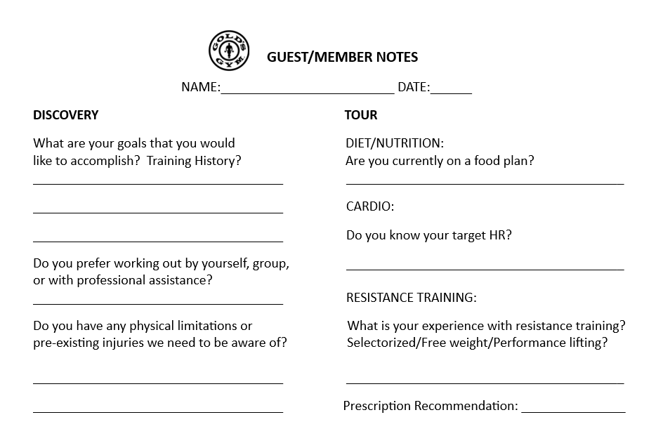
OUR SERVICE: QUALIFIACTION QUESTONNAIRE
Basic Questions to ask to GTKY guest:
What health and fitness goals would you like to accomplish?
What does your diet/nutrition consist of?
Do you know your THR?
What is your experience with resistance training?
Do you have any physical limitations or pre-existing injuries we need to be made aware of?
Have you ever worked with professional assistance or had a program designed for you?

Slide 12
OUR SERVICE: AMENITIES
As we tour our guests ensure that we touch on and highlight the below features to the gym:
CARDIO DECK
Highlight different modalities of training cardio (Ask prospect what their preference are, THR question from member notes)
WEIGHT AREA
Highlight different areas, free weight, cables, sectorized, specialized pieces, DBs up to 200 lbs. (Ask prospect on their experience; question from member notes)
GGX & STUDIOS
Highlight class modalities and concentrations, touch on schedule, favorite or most popular classes
FUNCTIONAL/PERFORMANCE HUBS
Highlight popularity of this function, how this contributes to longevity, sports performance, assistance that we provide with these new/progressive movements.
STRETCH AREA
Highlight importance of flexibility, circulation, mobility along with how we can assist with myofascial release, etc
LOUNGE/RETAIL AREA
Point out importance of hydration, pre/post-workout nutrition, featuring GGN brand, as well as cool gear to purchase, and new member promotions/discounts.

Slide 13
OUR SERVICE: THE TOUR
Every guest gets a red-carpet experience provided by management that educates and builds value on our tour.
Establish a business rhythm to create an outline of your tour
While we highlight the amenities and features of our gym, remember to use a 5 Component Tour to guide our cadence
GOAL SETTING
NUTRITION
CARDIO
RESISTANCE TRAINING
PROFESSIONAL ASSISTANCE
STEP 1
STEP 2
STEP 3
STEP 4
STEP 5

Slide 14
OUR SERVICE: EDUCATE
EDUCATIONAL TOURS BUILD VALUE...
GOAL SETTING
NUTRITION
CARDIO
RESISTANCE TRAINING
PROFESSIONAL ASSISTANCE
Discover the guest’s goals
What they want to accomplish, by when?
Why? SEE
Clearly Defined?
CAL I vs CAL 0
MACROS
Foods Recommended & Nutritional Counseling
GOLD’S Nutrition
THR analysis
Different modalities
Low intensity vs high intensity
Burning muscle vs fat-burn utilization
Benefits of strength training
Improved bone health
Functionality
Metabolic rate, 1 lb of muscle
Machine vs Free weights
Corrective
Stabilization
Injury Rehabilitation
Injury Prevention
Program Design
Motivation
Accountability

Slide 15
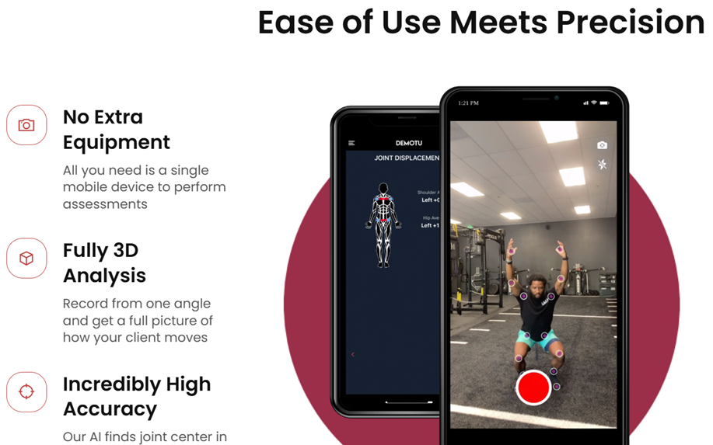
OUR SERVICE: LEVERAGE TECHNOLOGY
DEMOTU
Educate guest on what we offer…
Bio-mechanics
Squat Test Analysis
Injury Prevention

Slide 16
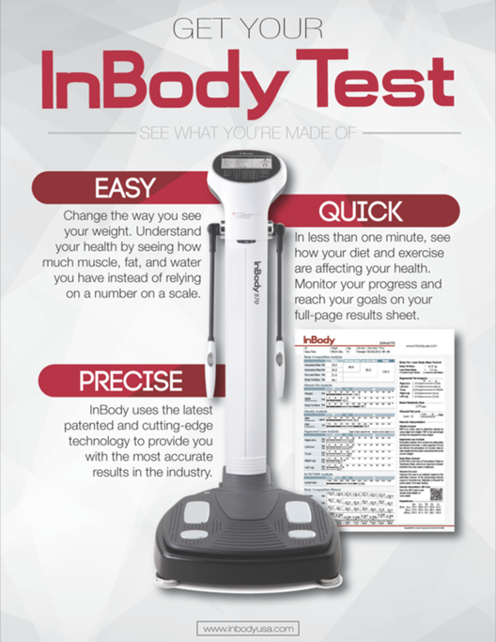
OUR SERVICE: LEVERAGE TECHNOLOGY
INBODY
Educate guest on what we offer…
Body Composition
Skeletal Muscle Mass
Body Fat %
Metabolic Rate | Caloric Needs
Tracked Progress

Slide 17
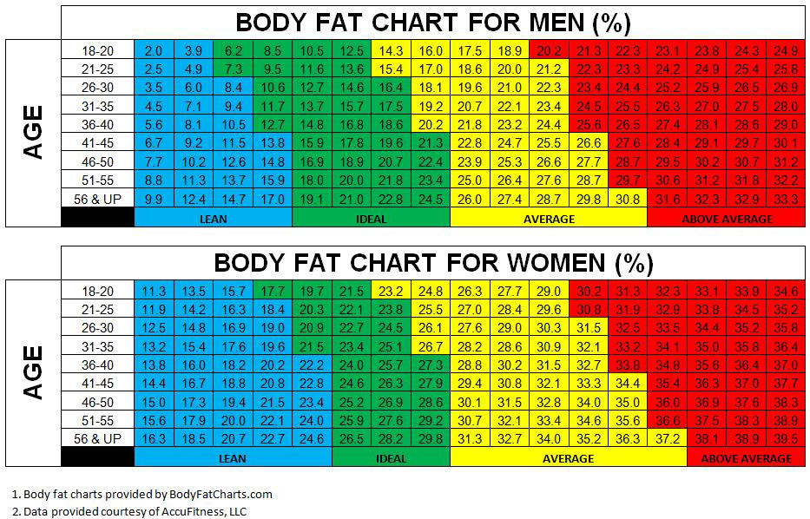
OUR SERVICE: LEVERAGE RESOURCES
For some guests speaking of HEALTH resonates more than weightloss…
What category do they fall?
Where do they want to be?
Deemed healthy for their age
Where is there concern/danger?
JAMA (Journal of American Medical Association) correlation of obesity linked to:
DIABETES/HEART DISEASE/STROKE/CANCER

Slide 18
OUR SERVICE: BEST PRACTICES
As you continue to grow and learn these steps, here are a few tips to help you along the way:
If guest allows, have a seat in the lobby or at a table to connect with them on their goals/qualifying stage
Always try to introduce guest to a PT
Ask them if they would like an INBODY scan/reading (opportunity to leverage and educate)
Showcase your PT BIO wall (highlight PT success or someone you think they would matchup well with)
Offer to show/demonstrate a new piece of equipment or encourage them to try one out
Ensure we transition to a prescription-based recommendation; ask for sale

Slide 19
OUR SERVICE: CLOSING
PRESCRIPTION BASED RECOMMENDATION
Based on discovering a prospect’s goals, we offer a professional fitness recommendation with a realistic timeline to achieve said goals.
SCRIPTING/EXAMPLE
At Gold’s Gym we take a healthy approach to achieve and sustain results. We do this on the notion of 1 to 2 lbs of fat loss per week, accompanied with an efficient nutritional program. Ms. Jones, based on you wanting to lose 20 lbs, we are recommending a 12-week program: A Preferred Gold membership, 24 or 36 sessions, where you are seeing a personal trainer 2 to 3 times per week. This is what it would take to get the professional assistance needed to achieve your goals.
REMEMBER TO ASK FOR THE SALE
Does this sound like something you are ready to commit to? Which of the two options makes most sense to you? Let’s pick one out and get you started/scheduled.

Slide 20
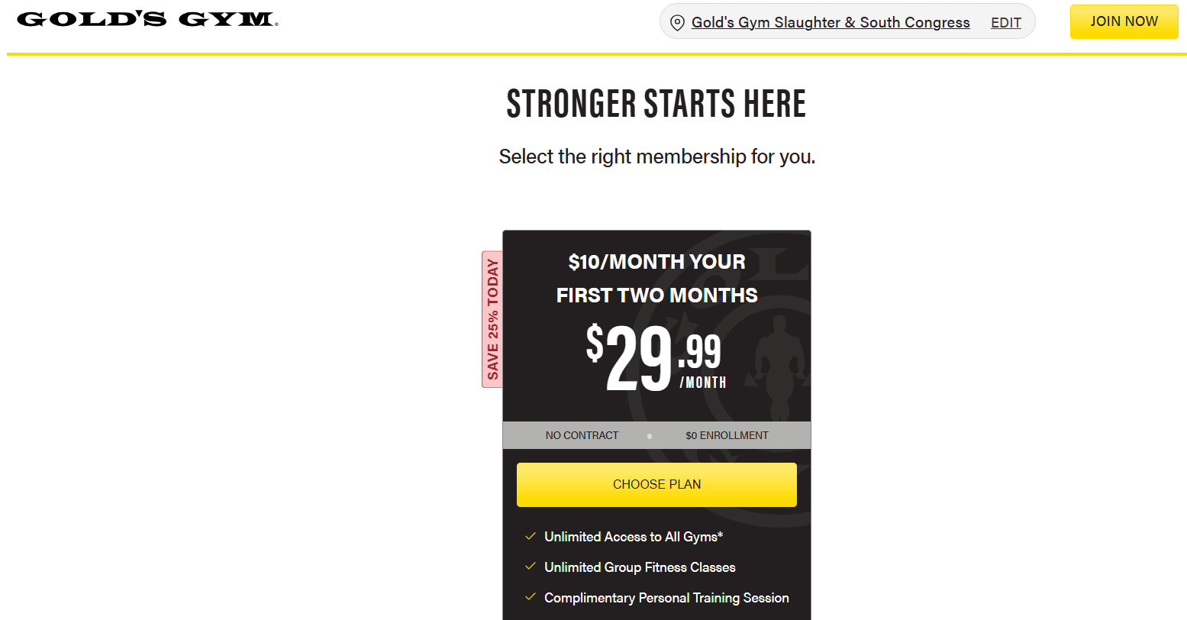
OUR SERVICE: PRESENTING PRICE
SHOW HOW EASY IT IS FOR A MEMBER TO GET STARTED…
Always present membership options from the kiosk…this builds credibility & consistency with staff
Always present PT options from a visual aid to showcase value/savings
Present the options needed/recommended for them to achieve their goals
Get them started today…ask for their commitment to join and begin their fitness journey!

Slide 21
OUR SERVICE: APOS/ POS CLOSE
WIN WHEN YOU MISS - Almost to the finish line…don’t skip these 3 steps: fight sales fatigue by building value and continuing to leverage service culture to our new members with educating them on the following…
Every new member is offered PT at POS. When they choose not to get started right away with a personal trainer, we then offer them a complimentary session as an orientation to our gym. This is an important start to their fitness journey and introduction to the gym, that includes INBODY scan, DEMOTU reading, and workout. Goal is to book this today for their first workout.
CPTS
Ensure that we offer our family plan/rate and educate new member of benefits & value
Statistics prove that you achieve goals and sustain consistency when working out with a friend or family member
$5 off retail rate, no contract, & does not include an annual fee
FAO
By becoming a new member today, this allows for 20% off R&C in your first week
Introduce & educate on GGN products (pre-workout & creatine gummies)
Highlight or showcase a new retail shirt, hoody, bag/cap
GGN & R/C
Transition to wrapping up with the GG APP...

Slide 22
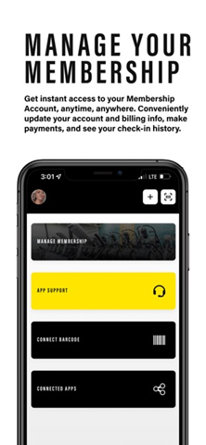
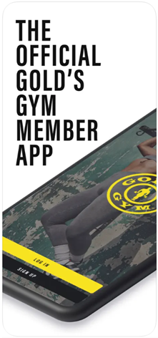
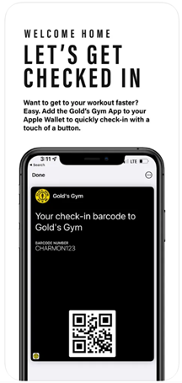
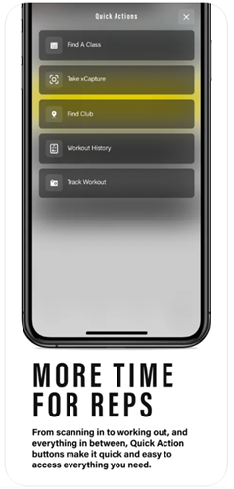
OUR SERVICE: GOLD’S GYM APP
Ask member to download the app before they leave
Highlight some of the apps features: easy check-in with barcode, find & book a class, manage your account

Slide 23

OUR SERVICE: THANK THEM
SHOW APPRECIATION FOR THEIR BUSINESS
WE ARE IN THE BUSINESS OF CHANGING LIVES
Leave a great first impression
Create a memorable experience
Leverage community
Educate fitness better than the competition
Make a friend
Thank them for joining/coming in

Slide 24

OUR SERVICE: GROUP BREAKOUT
CASE STUDY | PRACTICAL
Meet FRED…
55 yr old tech executive that works too much
Elevated BP and high cholesterol
Just became a grandpa and can’t keep up with grandson
Would like to get healthy, whatever that looks like
Practice makes perfect…Roll play different scenarios with the team in gym.
Practice what we’ve learned today
Apply 5 Step Sales Process Outlined Above
Don’t skip steps…
Remember to be personal and enthusiastic
Did we pinpoint and isolate goals/concerns?
Did we find SEE?
Did we educate guest and share fitness knowledge?
Did we make a prescription based recommendation?

Slide 25

OUR SERVICE: GROUP BREAKOUT
CASE STUDY | PRACTICAL
Meet Ruby…
30 yr old SAHM of two let herself go after having kids
Scared of gym floor and only likes classes
Thinks she has to give up foods she likes
Wants to feel like old self and bring her sexy back
Practice makes perfect…Roll play different scenarios with the team in gym.
Practice what we’ve learned today
Apply 5 Step Sales Process Outlined Above
Don’t skip steps…
Remember to be personal and enthusiastic
Did we pinpoint and isolate goals/concerns?
Did we find SEE?
Did we educate guest and share fitness knowledge?
Did we make a prescription based recommendation?

Slide 26
OUR PRODUCT
Clean gyms will help us retain our members. The goal is to increase the gyms overall cleanliness & NPS score.
It is important that the GMs own the cleanliness of the club whether you outsource the cleaning or employ a hybrid model.
This will assist in changing the perception of our members that we are working diligently at keeping our facilities clean creating a better member experience.
A walk thru should be done by any team member (other than the housekeepers) 4 times a day where they focus on the Daily Checklist.
The Daily Checklist should be filled out by the team member and signed off by a Manager. Checklist should be kept in Cleaning Binder at Front Desk in a 1-31 fashion.
CHECKLIST WILL CONSIST OF 9 AREAS OF THE GYM
Front Entrance
Locker Rooms (Men & Women)
Cardio Area
Free Weight Area
GGX Studios
Cardio Cinema
Kid’s Club
Studio Rooms

Slide 27
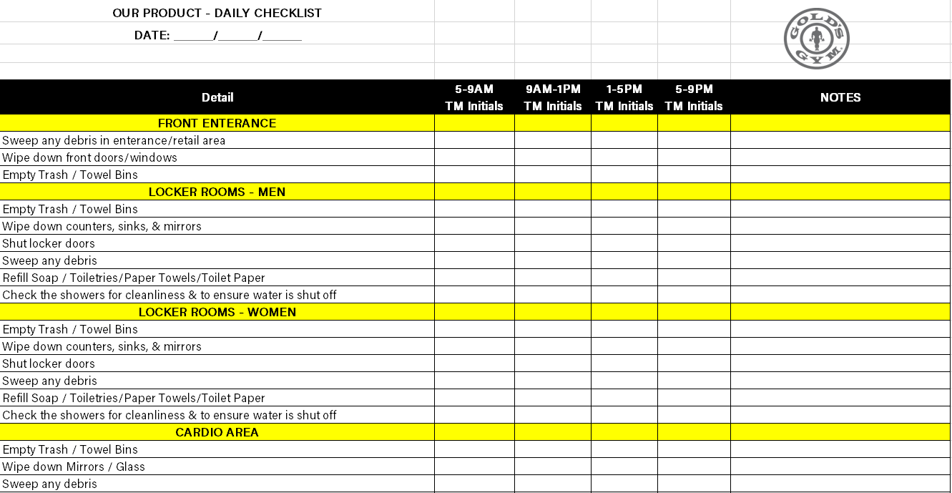
OUR PRODUCT: TEAM MEMBER WALK THRU
AGM completes the first of four-team member walk throughs when they arrive and completes TM checklist.
The AGM is the second set of eyes for the club and assists in aligning with club expectations.
Any team member completes the 3 remaining walk throughs and completes checklist.
These walk throughs should reset the club to standard set during the GM walk though.

Slide 28
OUR PRODUCT
The GM Daily Walk Thru should be the first thing the GM does when arriving to work to ensure the club is clean and orderly.
The GM Daily Walk Thru Checklist should be filled out by the GM (AGM during days the GM is off).
Checklist should be kept in a GM Daily Walk Thru Binder in the GMs office in a 1-31 fashion.
If the club is not in order, the GM is responsible for tending to the issue, filling toilet paper, paper towels, soap, cleaner, etc.
If something is discovered on the walk thru that is broken and has not been ticketed yet, please ticket item in Service Channel. Quickest to ticket directly thru your phone. If not thru phone, then computer.
CHECKLIST WILL CONSIST OF 10 CATEGORIES
Front Entrance
Locker Rooms (Men & Women)
Cardio Area
Free Weight Area
GGX Studios
Cardio Cinema
Kid’s Club
Studio Rooms
MISC.

Slide 29
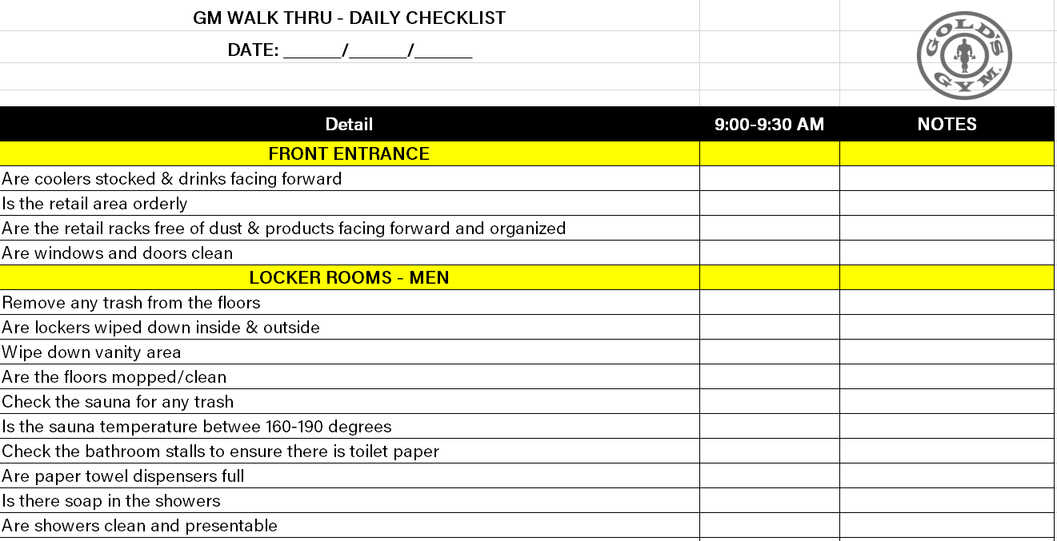
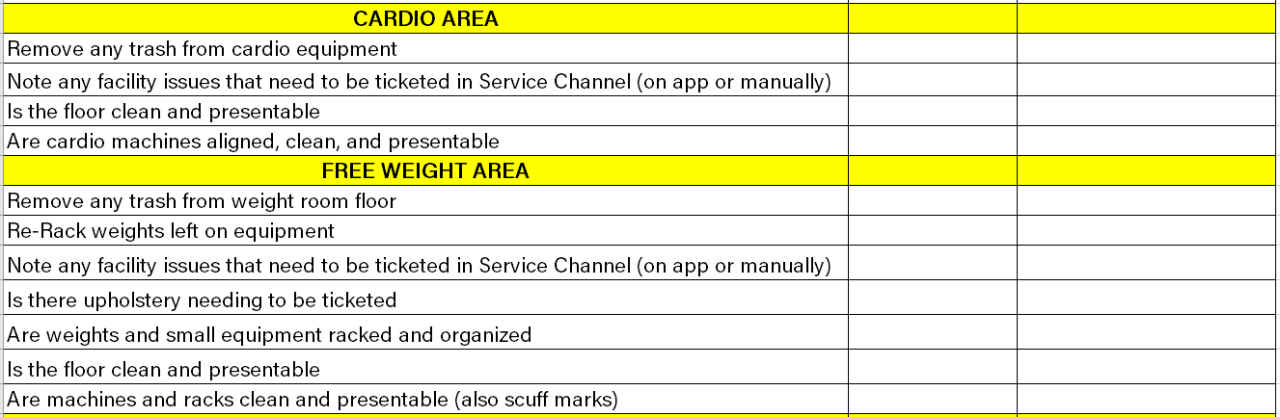
OUR PRODUCT: GM WALK THRU
GM conducts walk through when they arrive at the gym and completes GM checklist.
The GM will set the standard for the club each day by addressing any issues and identifying areas of opportunity.

Slide 30
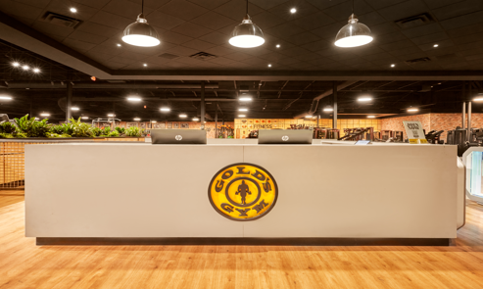
OUR PRODUCT: FRONT DESK
GYM WALK-THOUGH
Scanners working and clean.
Signage current and properly displayed.
Glass windows and doors clean.
Counters clean and presentable.
Floor mats straight and vacuumed
Kiosks functional and displaying correct info.

Slide 31
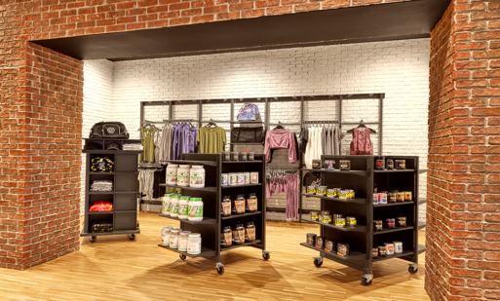
OUR PRODUCT: R&C
GYM WALK-THOUGH
Retail displays positioned properly.
All racks and gondolas dusted
Apparel hung neatly with no empty hangers.
T-shirts folded and organized by type.
Supplements front facing and dust free.
Coolers functional (Lights on, cooling properly).
Coolers glass and shelves clean.
Coolers stocked.
All product in coolers front facing.

Slide 32
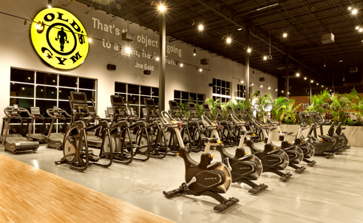
OUR PRODUCT: CARDIO
GYM WALK-THOUGH
All cardio equipment aligned.
Dust collecting under treadmills
Visible wear and tear ( Seats, treadmill belts, bike pedals, ETC.)
Screen displays functional Is the equipment functional.
Trash in cupholders.
Sweat accumulation/streaks ( Exp. Base on recumbent Bikes)
Emergency stops reset.

Slide 33
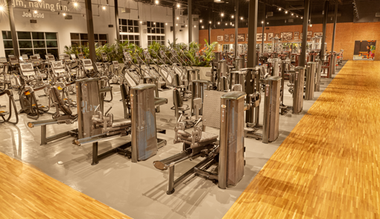
OUR PRODUCT: SELECTORIZED
GYM WALK-THOUGH
Worn or broken cables/bands.
Missing weight stack pins.
Dirt and debris build up around base.
Dust collecting on equipment.
Upholstery wear and tear.
Hand grips torn or missing.
Missing or loose knobs/adjustment leavers.
Pealing labels (Weight stack numbers, users guide, etc.)

Slide 34
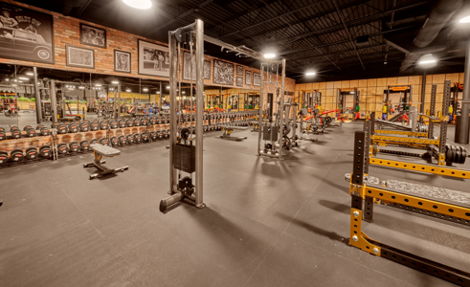
OUR PRODUCT: FREEWEIGHTS
GYM WALK-THOUGH
Dumbbell racks inline and clean.
Dumbbells and barbells in designated spot.
Utility benches aligned.
Mirrors clean.
All barbells present with clips.
Weight plates organized and off the floor.
Platforms clean and free of chalk.
Tops of racks clean and dusted.

Slide 35
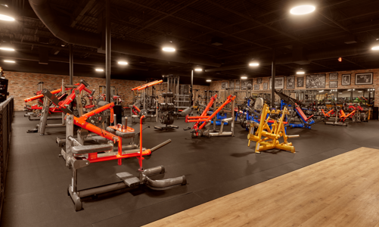
OUR PRODUCT: PLATE LOADED
GYM WALK-THOUGH
All barbells present with clips.
Weight plates organized and off the floor.
Platforms clean and free of chalk.
Tops of racks clean and dusted.
Weight plates racked.
Weight trees organized.
Mirrors clean.

Slide 36
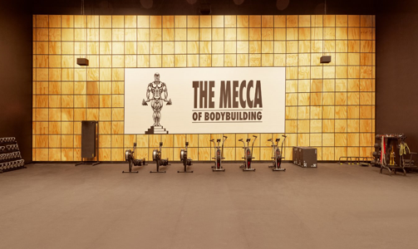
OUR PRODUCT: FUNCTIONAL
GYM WALK-THOUGH
Kettlebells and dumbbells racked neatly.
Bands and jump ropes organized.
Plyo boxes organized.
Rowers and bikes clean.
Batteries replaced in equipment if needed.
Small equipment neatly displayed (organized chaos).

Slide 37
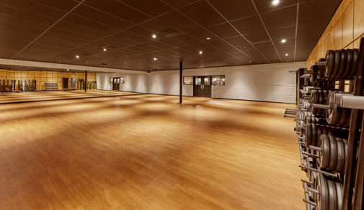
OUR PRODUCT: GGX
GYM WALK-THOUGH
Weights organized in designated racks.
Mats hung on racks.
Steps stacked neatly.
Bars and clips stored properly.
Schedule displayed and updated.
Mirrors cleaned.
Headsets and transmitters stored properly.

Slide 38
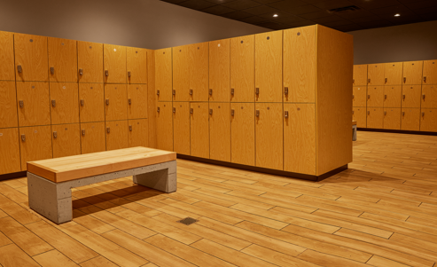
OUR PRODUCT: LOCKER ROOMS
GYM WALK-THOUGH
Sinks and counters clean and dry.
Soap dispensers filled.
Toilet paper and paper towels stocked.
Mirrors clean.
Lockers closed and functional.
Inside and tops of lockers clean.
Shower curtains clean with no missing rings.
Stalls and urinals clean.

Slide 39
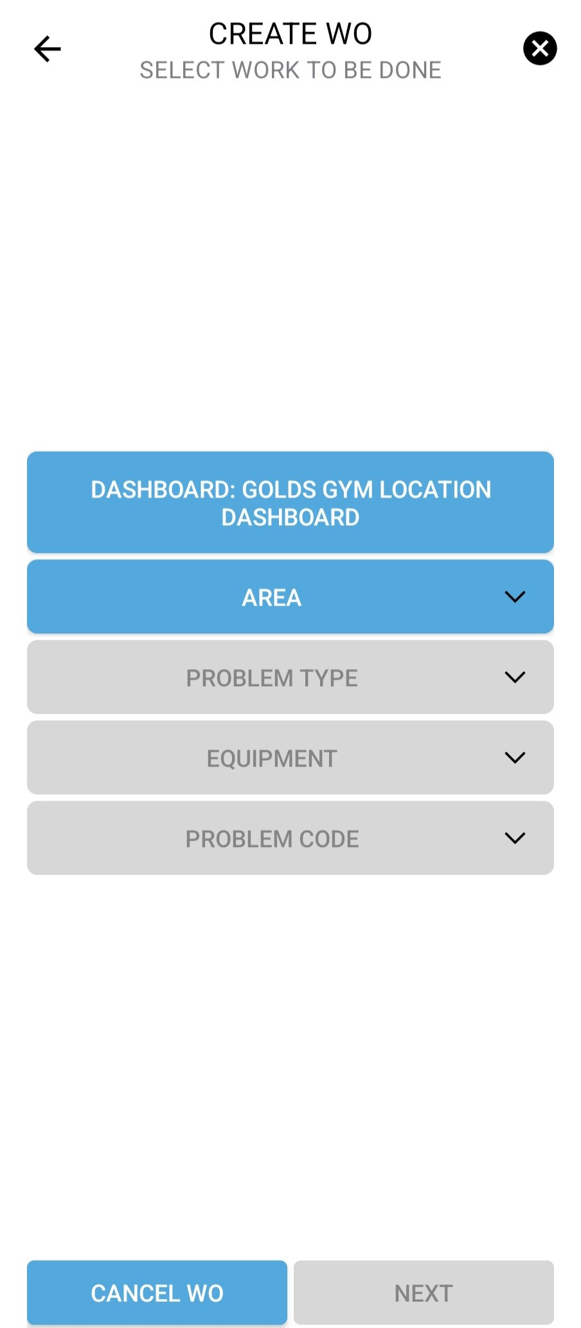
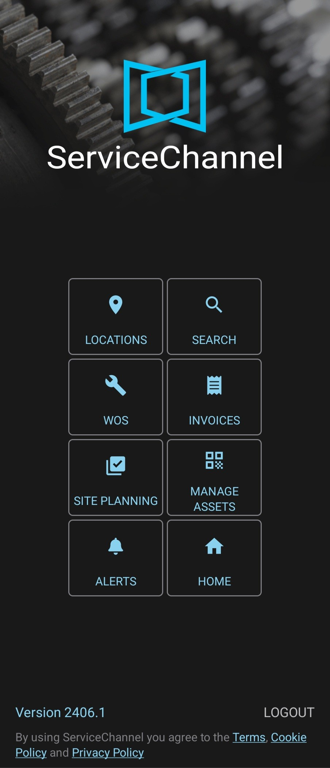
OUR PRODUCT: SERVICE CHANNEL
Completing service channel work orders ensure our facility repairs get completed in a timely manner and offers manager oversight and status updates on all tickets created.
Utilizing the mobile app is allows managers to complete work orders while completing their walkthroughs opposed to having to wait until returning to an office.
As you are creating a new work order you will go through a series of questions and options that you will select:
If a work order is needed for a piece of Gym equipment, please locate the Asset tag ID # information that will be needed for the work order

Slide 40
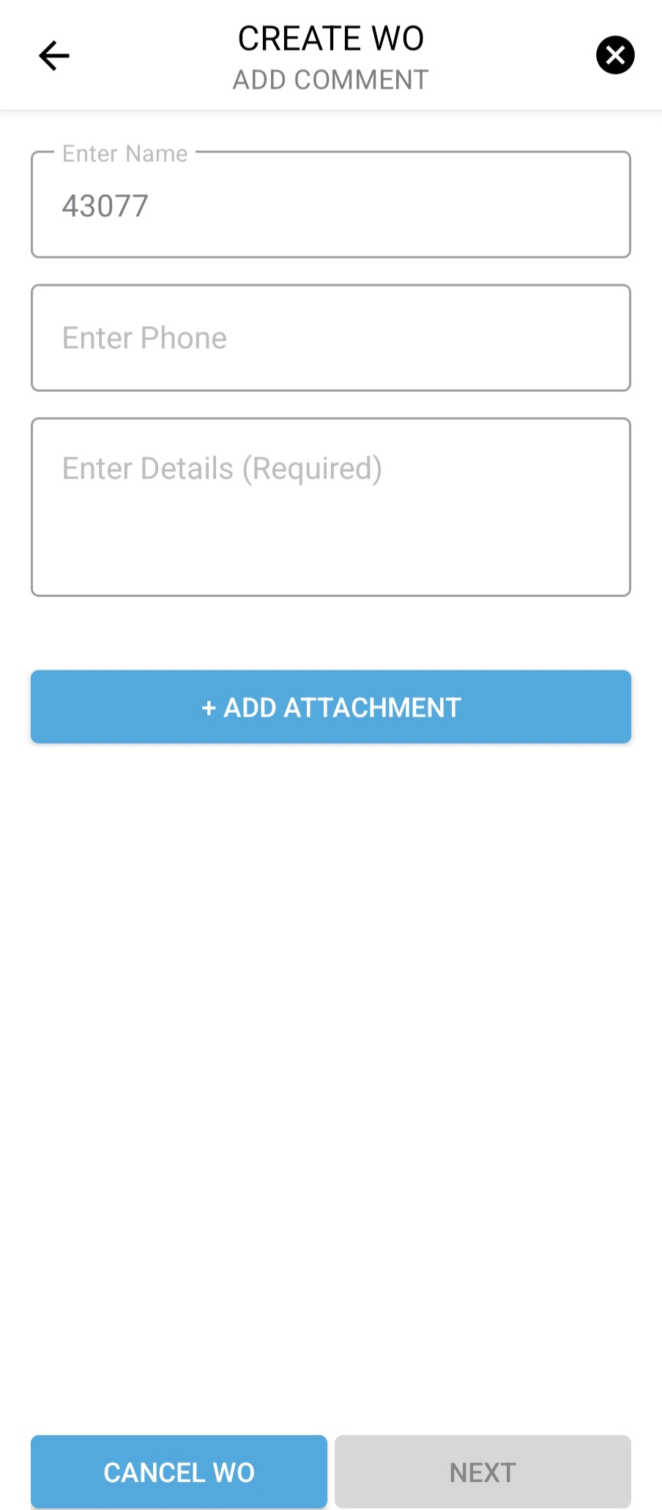
OUR PRODUCT: SERVICE CHANNEL
As you continue to create a work order, you will come to a Problem Description section where you will need to be as descriptive as possible for the repairs needed.
When creating a work order your able to add pictures to the work order. Adding pictures helps the Facility managers with needed repairs.
Once you complete and submit the work order, it will automatically email your Facility manager the work order you just created.

Slide 41
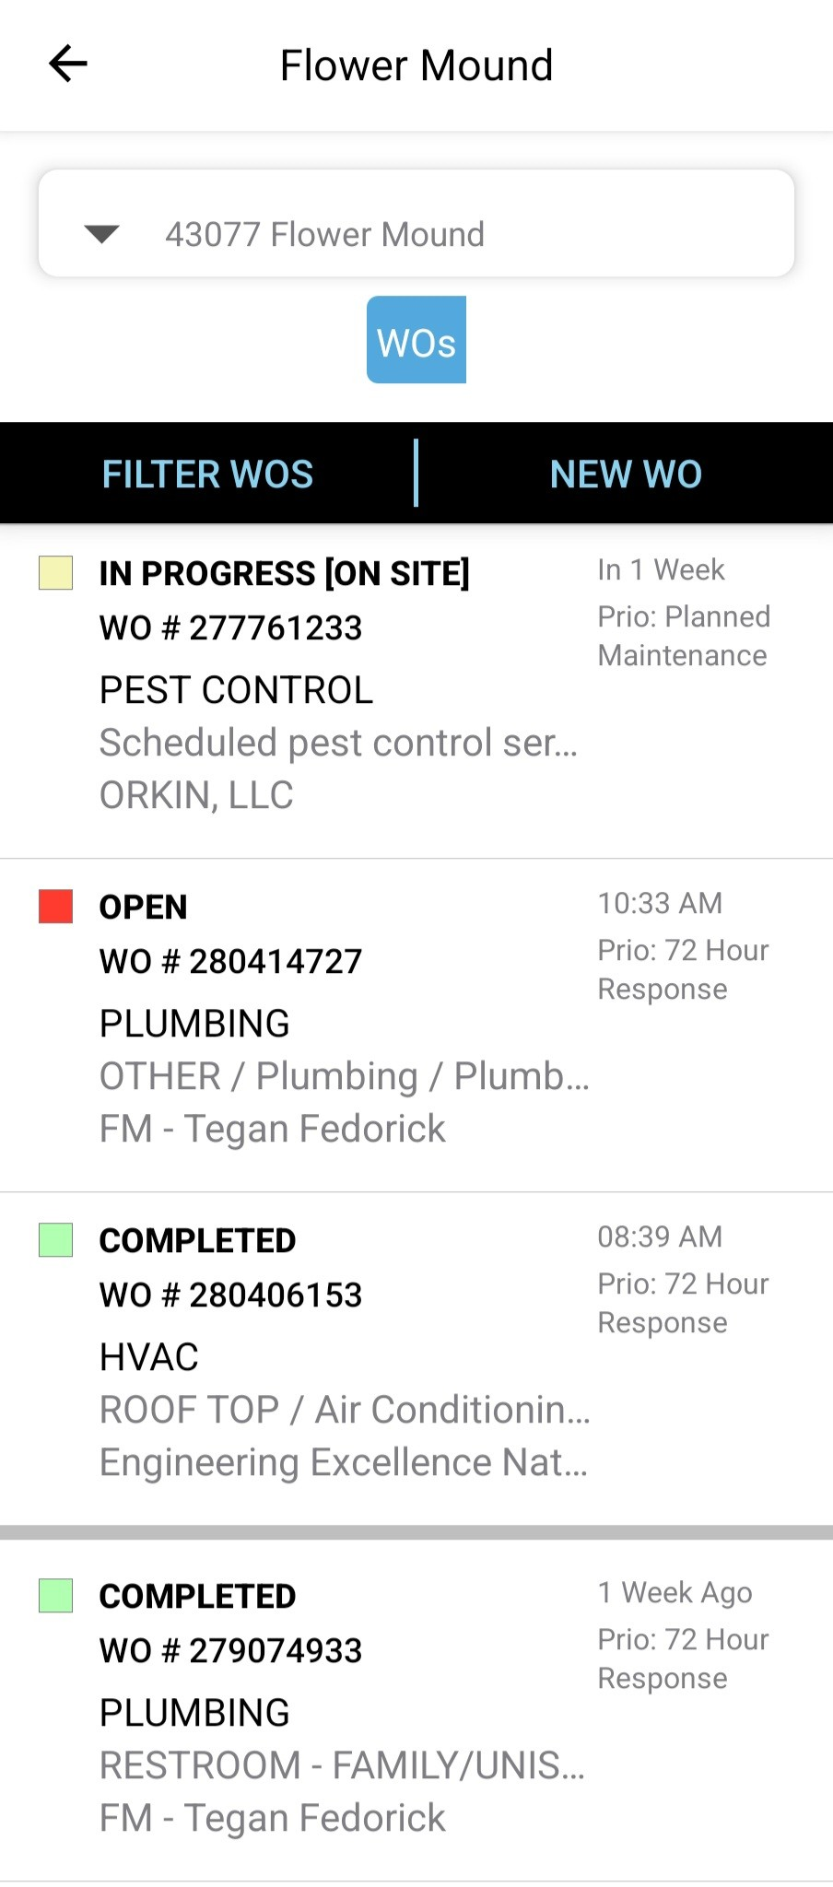
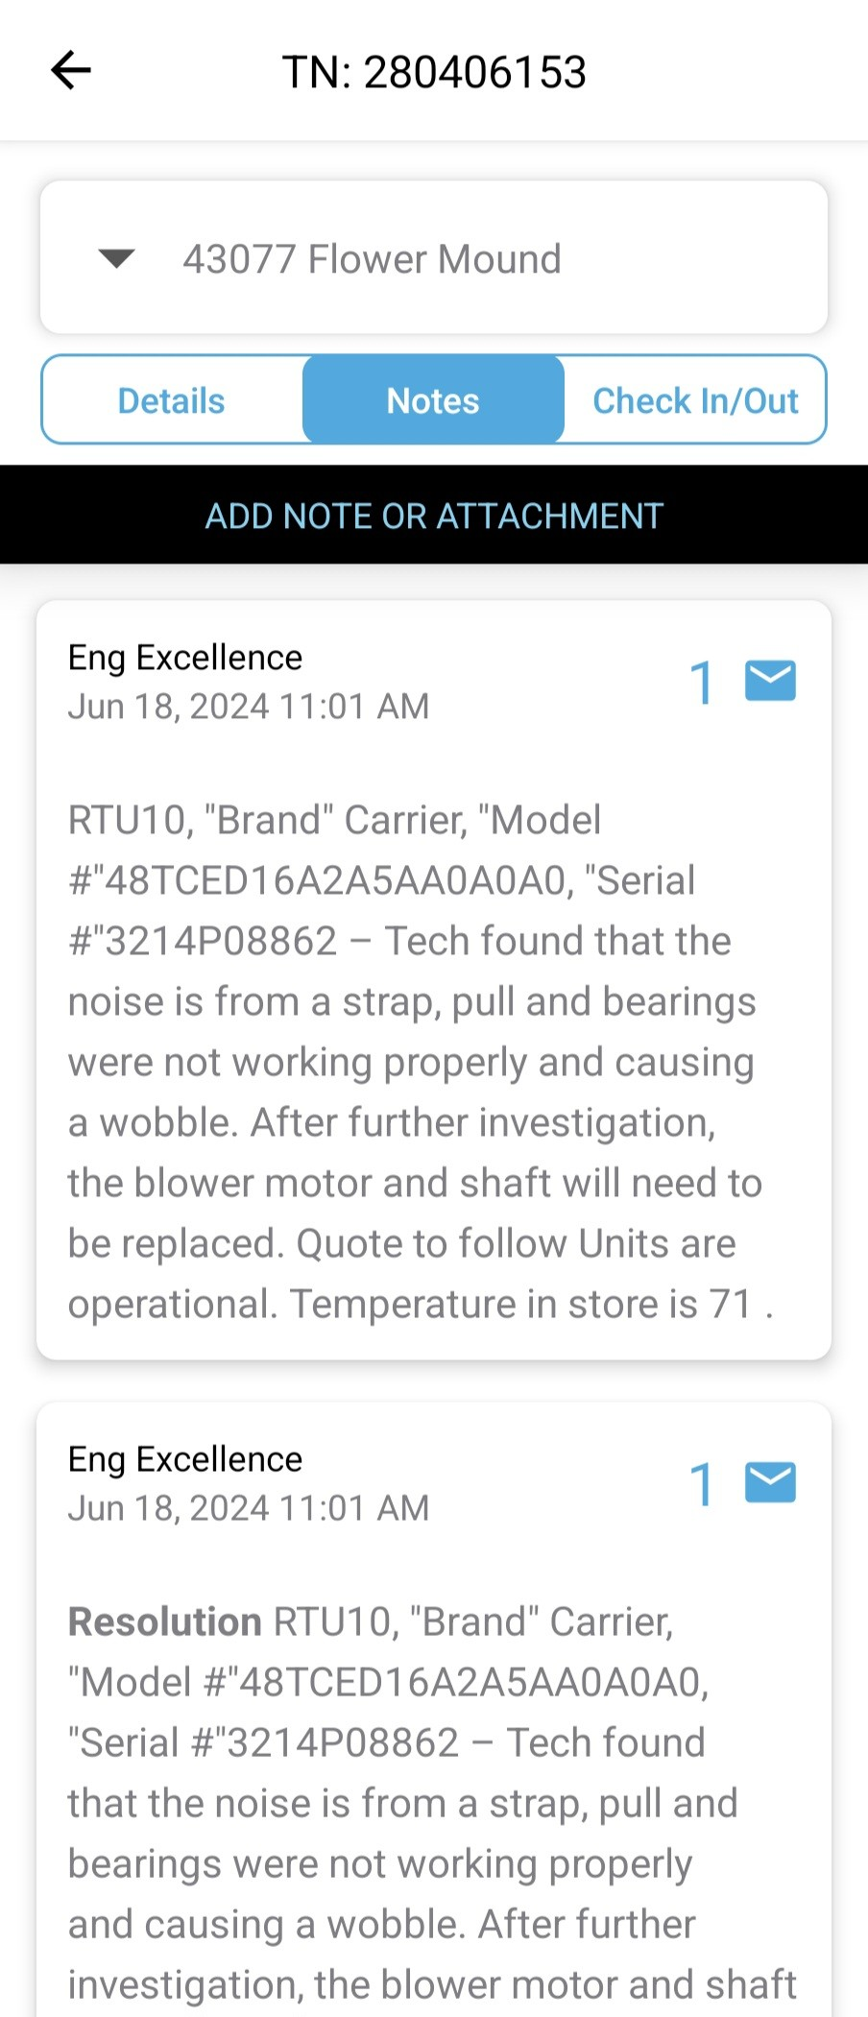
OUR PRODUCT: SERVICE CHANNEL
You can keep updated on the progress of your club's repair work orders by clicking on the View Open Work order tab. With this feature you can check the status of the repairs and look at the notes that the Facility managers has entered.
If there is a particular work order you want to check the status and notes, click on Details and it will bring you to this screen where you can see the status and notes for a particular work order.
If you would like to add any notes or updates, just click on “Add New Work Order Note”

Slide 42



OUR MEMBERS: CANCELLATIONS
Listen without Judgement
People want to be heard so ask open ended questions and engage in conversation.
Don’t try to convince them immediately—just listen and take notes.
Gather Feedback
Exiting Members offer valuable insights. Conduct a short verbal exit survey to ask things like:
Cost?
Schedule?
Equipment?
Results?
Offer an Alternative
You may be able to retain the Member with a better fit (if appropriate). What does that look like:
Comp PT Session?
Different PT?

Slide 43
OUR MEMBERS: SAVE PROCESS
1
2
3
4
Why are you cancelling?
Is there anything we can do to rectify the situation?
Is there something we could have done better or differently?
What can we do to keep you as a Member?
WHY WE DO THIS
It costs 3 times more to acquire a new Member than to retain an existing one
so it’s critical to invest time to help Members understand the value of our services when they want to cancel.

Slide 44
OUR MEMBERS: CANCELLATION - NEXT STEPS
The Member is just not interested in continuing their membership and still wants to cancel – WHAT NOW?
A bad cancellation experience can turn a neutral Member into a vocal critic so it’s important to make a Member’s exit experience seamless and pleasant. To do that, we want to ensure the following:
Be transparent about cancellation terms
This includes the 30-Day notice and any early termination requirements when applicable
1
Process cancellation promptly
2
To ensure Member is not billed past 30-Day notice from original cancellation request date
Thank Member for their continued patronage
3
How you treat a Member on the way out influences whether they return in the future

Slide 45
OUR MEMBERS: CANCELLATION METHODS
Any form of written notice is accepted – we cannot require Members to physically visit a club or go online to submit their cancellation request in writing.
ACCEPTABLE REQUESTS:
Signed Cancellation Questionnaire in Club
Online request submitted via Gold’s Gym website
Email sent to:
General Manager
Club’s Contact Inbox
Cancellations@goldsgym.com
Mailed letter to local club or Dallas Support Center
Certified mail, return receipt requested is recommended but NOT required
UNACCEPTABLE REQUESTS:
Verbal – over the phone or in person
Unauthorized – person that is NOT the:
Member
Primary Account Holder
Legal Guardian of a Minor/Member
PLEASE NOTE:
Member cancellation requests cannot be refused based on any past due balance.
Payment and a new funding source should be requested from the Member at the time of cancellation request.

Slide 46
OUR MEMBERS: CANCELLATION INTERNAL PROCESS
The following steps outline the proper procedure for processing a Member’s cancellation to ensure consistency, compliance, and a positive experience. Each step must be completed thoroughly to protect both the Member and the business.
VERIFY
Verify Member’s cancellation eligibility and advise Member of cancellation terms
Request/Review supporting documents from in-obligation members for early termination
1
COLLECT
Collect acceptable written cancellation request from Member
Cancellation Questionnaires – ensure management review/approval section is completed
2
SUBMIT
Submit cancellation via internal Cancellation Portal
If unable to submit cancellation through portal, contact Customer Care for help processing
3
NOTE
4
Add note in MOSO to document Member’s cancellation for future reference

Slide 47
STRONG
FITNESS
OPERATING MODEL

Slide 48
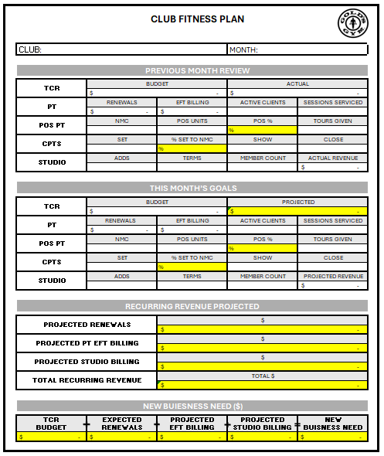
OUR PROCESSES: CLUB FITNESS PLAN
Reviewing our fitness business allows us to set specific actionable items to coach our team to success. We should not get to the end of the month and be surprised at the outcomes. If you are not assessing, you are guessing.
1
OVERVIEW
Complete Club Fitness Plan at beginning of the month
PT Business Plans must be completed prior, to understand projected renewals.
GM and AGM should review and align on expectations for the club as a leadership team.
2
REVIEW
Compare previous months performance to goal
Understand what opportunities there are (CPTS, POS PT, AC, SS and Recurring)
These opportunities should guide realistic goal setting for current month.
Goals should align with business needs.

Slide 49
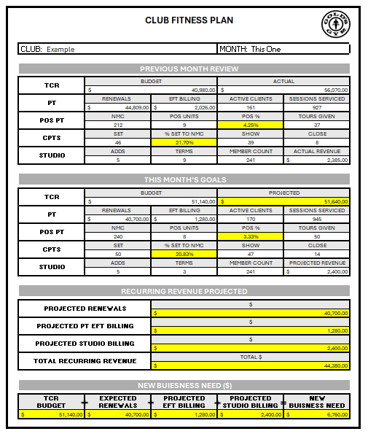
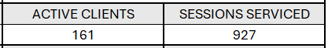
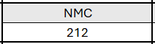
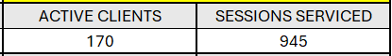
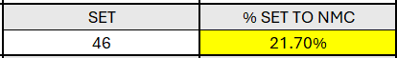
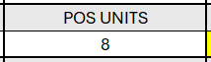
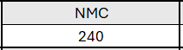
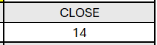
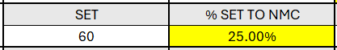

OUR PROCESSES: REALISTIC PROJECTIONS
When setting goals, do not just add what would be needed to hit budget. You should compare prior month and understand what growth is realistic.
When projecting active clients, you need to account for new business AND your client attrition.
This club is projecting 22 new client adds but only growing by 9 clients. This projects 8% client attrition.
This club is projecting 3.3% growth, this does not achieve the 30% expectation, but 14 adds is realistic and attainable.
This logic should be applied for all metrics.

Slide 50
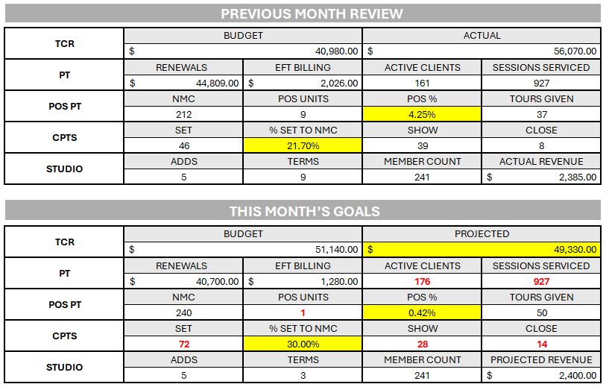
CLUB FITNESS PLAN: REVIEW
When goals greatly differ to prior month, you should understand If there is an actionable plan that accounts for these variances.
Review example.
Set – 30% is the company goal, is there a tangible plan to add 26 additional appointments?
Show – Why did the shows drop 46%?
Close – Is 30% increase in closes realistic?
POS – Why are POS units projected so low?
Active Clients – With 15 new clients added this month, are we projecting no client attrition?
Sessions Serviced – If we are projecting 15 new clients added, why are sessions serviced the same as prior month?

Slide 51
OUR MEMBERS
Our member engagement is the key to a successful fitness program. There is no one focus that will drive our business to success. Recognizing all the components and setting standards of achievement will allow us to support our members and build our fitness brand.
RESULTS STANDARDS
80% Existing Clients Renewed
50% New Clients Renewed
30% CPTS Attachment
20% CPTS Closed
2% POS PT Attachment
100% TCR
OUTCOME
400 TRAINERS SERVICING 4000 CLIENTS

Slide 52
OUR PRODUCT
^
FITNESS

Slide 53

OUR PRODUCT: GP3 INTRO
Purpose and System Phases Overview
Empowering Trainers:
Equip every trainer with the tools and knowledge to confidently deliver the GP3 client experience.
Three-Phase System:
Guide clients through Path, Program, and Progress—each tailored for strategic development and performance tracking.
Client-Centered Philosophy:
Focus on personalized, professional, and proven results from assessment to ongoing evaluation.
Notes:
Welcome to the GP3 Training Manual—your essential guide to delivering the Gold’s Premier Performance system with excellence. This manual is designed to empower trainers with a structured approach that ensures clarity, consistency, and client success.
We operate through a three-phase framework: Path, Program, and Progress. Each stage is engineered to assess, deliver, and re-engage with precision. Trainers will move beyond the basics, learning how to leverage tools and protocols that make every session impactful.
Ultimately, the goal is to create a client experience that is personalized, professional, and proven. This manual provides the blueprint to make that vision a reality from day one.

Slide 54

PERSONAL PERFORMANCE PROCESS
GP3
1
PATH
2
PROGRAM
3
PROGRESS
CPTS
Composition Assessment
Movement Assessment
Program Recommendation
Program Demonstration
GROUP + PT
Digital Platform
Pre-Programmed Workout Library
Uniform Fitness Offerings
Clear Client Path
EVALUATION
Enhanced CPTS Follow-Up
30-Day Re-Engagement Tool
Fitness Progress Re-Evaluation
Personalized Program Adjustments

Slide 55
Welcome, Assessments & Program Preview
OUR PRODUCT: PHASE 1 - PATH
The first step in the GP3 is the Path which is the CPTS. The CPTS can be done in 30-minute or 60-minute session depending on the client's needs and preferences, making it possible for more members to participate. The 30-minute session will allow our trainers to fully assess the clients current state of fitness and make recommendations for achieving their goals. The 60-minute session will allow the trainer to demonstrate how we can help them achieve these goals.
Personalized Welcome: Establish trust and set expectations by framing the client journey from day one.
Client onboarding: Compete PAR-Q, understand client goals and what plans they have to reach them.
InBody Composition Assessment: Capture and interpret key metrics like body fat %, lean mass, and weight using the InBody scanner.
AI Movement Screening: Utilize DEMOTU to identify mobility inefficiencies and joint imbalances for informed program selection.
Tailored Program Recommendation: Guide clients into the most suitable track: Gains, O2, Live, Drive, or Specialized.
Optional Program Preview: Deliver a 25–30 minute trial session including key phases to boost engagement and confidence.
Notes:
In Phase I of the GP3 system—Path—we initiate the client journey with intention and clarity. This starts with a warm, professional welcome that frames the training experience and aligns expectations from the very beginning.
Next, the InBody composition scan provides objective insight into body composition, enabling trainers to personalize coaching in a lifestyle-relevant language. This is followed by an AI-powered movement assessment using DEMOTU, helping trainers identify asymmetries and mobility limitations crucial for selecting the optimal training path.
The process concludes with a track recommendation tailored to the client's goals, and an optional 30-minute preview session that integrates the Protect, Progress, and Perform sequence. This thoughtful, data-driven onboarding lays the groundwork for a high-impact client journey.

Slide 56
OUR PRODUCT: CPTS WORKFLOW
Step 1: Member Welcome & Framing the Experience
Greet client personally
Set expectations: Today we’ll map out where you are and where you want to go
Step 2: Body Composition Snapshot (InBody)
Review metrics: weight, body fat %, lean mass
Interpret in lifestyle language
Log data into client profile on platform
Step 3: AI Movement Assessment (DEMOTU)
Walk client through movement protocol
Analyze results: joint imbalances, mobility issues, inefficiencies
Record outcomes and guide track selection
Step 4: Program Recommendation
Match to: Gains, O2, Live, Drive, Specialized
Step 5: Optional Program Preview
25–30 min session including Protect, Progress, Perform
Offer preview and feedback

Slide 57
During this stage, you need to fully understand what the client is trying to achieve. Once you complete the assessments, you will be able to paint a clear picture for achieving these goals and the time it will take to do so.
OUR PRODUCT: CPTS CLIENT ONBOARDING
PAR-Q
PTs should complete the PAR-Q with client ( Not hand to client to fill out like a check list). It should be conversational to fully understand their limitations, past and present.
Client goals
Understanding client's goals is more than a surface level conversation about them wanting to lose 15lbs for example. There are layers to their goals, such as:
What is their primary goals?
What does this goal mean to them and what does achieving this actually look like?
Are there secondary goals they want to achieve outside of their main focus?
What has prevented them from reaching these goals?
Do they have a plan to reach them now? Is it a good plan?
What is the timeframe to reach these goals? Do they have one and Is it realistic?
You have to earn the right to give them a recommendation. Just telling a client what they need based on assessments and surface level goals is difficult to do effectively without identifying the challenges they have faced in their fitness journey.
Notes:
In Phase I of the GP3 system—Path—we initiate the client journey with intention and clarity. This starts with a warm, professional welcome that frames the training experience and aligns expectations from the very beginning.
Next, the InBody composition scan provides objective insight into body composition, enabling trainers to personalize coaching in a lifestyle-relevant language. This is followed by an AI-powered movement assessment using DEMOTU, helping trainers identify asymmetries and mobility limitations crucial for selecting the optimal training path.
The process concludes with a track recommendation tailored to the client's goals, and an optional 30-minute preview session that integrates the Protect, Progress, and Perform sequence. This thoughtful, data-driven onboarding lays the groundwork for a high-impact client journey.

Slide 58
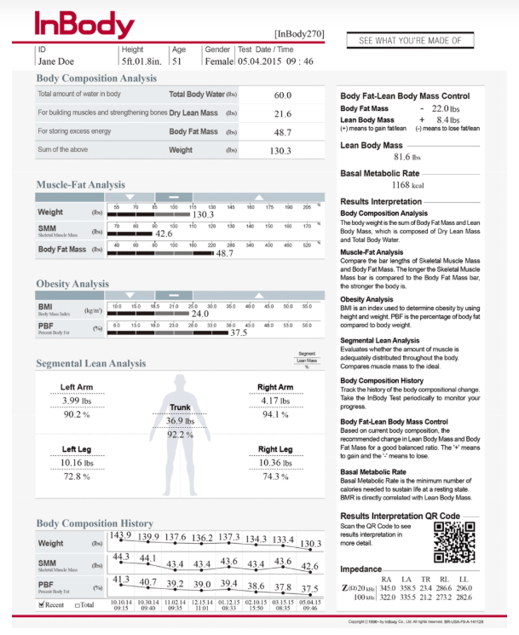
OUR PRODUCT: CPTS INBODY ASSESSMENT
This scan provides a comprehensive analysis, including muscle mass, fat content, and water weight. By decoding the results of the InBody scan, you can gain valuable insights into client's fitness levels and make informed decisions about their goals.
Scan overview
Scan results should be discussed with the client. This is an informative conversation to not only show the client their baseline body composition but to educate on how these results relate to their fitness goals
Discussion focuses
Muscle mass
Body fat %
Deviations in muscle mass from one side to another
Body weight goal vs importance of total body composition results.
PT’s should remind clients this is a baseline and discuss reevaluation intervals and milestones to look for.
All of these metrics will be important for setting timelines while making program recommendations.

Slide 59
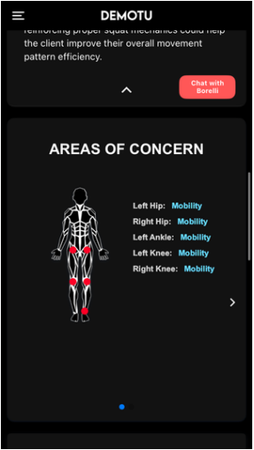
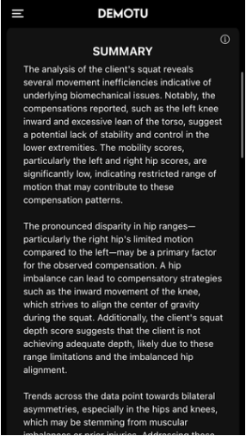
OUR PRODUCT: CPTS DEMOTU
Demotu provides a comprehensive breakdown for client's movement that will allow PTs to articulate to clients their movement compensations and joint stability issues that will impact their training program.
PT’s review the movement scan with client and highlight areas of concern. This gives a visual reference for clients to understand their mobility restrictions.
PT’s should then cover the summery of the movement assessment. Using this, the PT will outline the specific compensations and how they can be addressed through proper programming.
Notes:
Path starts with our enhanced CPTS: - Body Composition Assessment + Movement Assessment
Through our assessments, questionnaire and connecting with the member, we are confident in program recommendation
The PATH is our first impression –it has to be meainingful. . . Insightful. . . And most of all PERSONAL

Slide 60
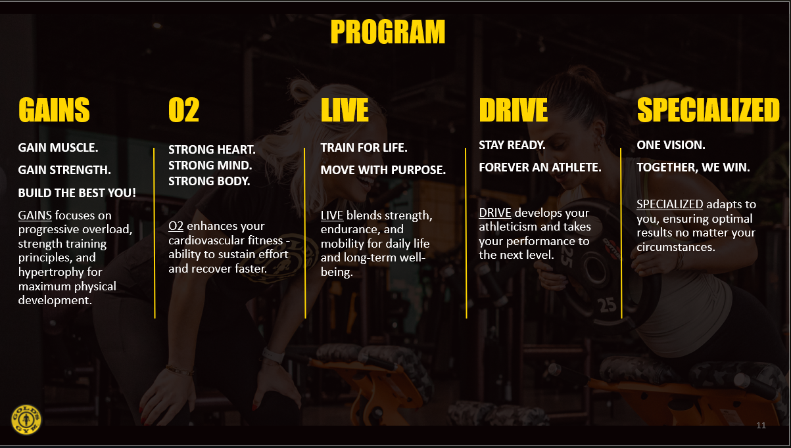
OUR PRODUCT: CPTS PROGRAM PRESENTATION
Now that we understand the client's goals, and their fitness status, its time to give a program recommendation.
Steps
Reiterate the client's goals
Recommend the program that achieves these goals
Describe what that program looks like
Provide solutions to areas of focus identified in the assessment portion and how the program will incorporate that.
Set a timeframe for achieving these goals with the prescribed program
Take the client through a program demonstration ( 60 Minute session only)
After completing the demonstration if a 60-minute session, you will need to recap the recommendation for the client when before presenting/ closing the training package.

Slide 61
OUR PRODUCT: CPTS CONVERSION
Providing a great experience doesn’t end with the workouts we provide. How we transition our members to clients is part of this experience. “Closing” CPTS’s should not be a cost-based presentation. PT’s should be focused on the product and how it benefits our clients.
Transition
1
Move from the workout to have an intentional conversation with the client and provide a professional prescription.
Confirm the goal
Outline the client's fitness goals and clarify any secondary goals discussed earlier in the session.
2
Establish a timeframe
3
Present a realistic timeframe to achieve the client's goals.
Present program
4
Explain to the client how they will reach these goals (Prescribed routine, Frequency, Duration and expected results)
Ask for the sale
5
Simply asking if the client agrees with the prescribed plan and would like to move forward.
Present the price
6
Presenting a clear price for the prescribed program.

Slide 62
OUR PRODUCT: PATH- CPTS
PAR-Q, training history and client goals
30 Min
CLIENT ONBOARDING
COMPOSITION ASSESSMENT
Body composition, muscle density, and overall health
MOVEMENT ASSESSMENT
Mobility & stability while identifying compensations
PROGRAM RECOMMENDATION
GAINS / O2 / LIVE / DRIVE / SPECIALIZED
60 Min
PROGRAM DEMONSTRATION
Let’s Train!
Notes:
Path starts with our enhanced CPTS: - Body Composition Assessment + Movement Assessment
Through our assessments, questionnaire and connecting with the member, we are confident in program recommendation
The PATH is our first impression –it has to be meainingful. . . Insightful. . . And most of all PERSONAL

Slide 63
OUR PRODUCT: PHASE 2 - PROGRAM
Session Framework
Overview
The Program framework is the core training experience of the GP3 system. It follows a structured system designed to deliver safe, progressive, and results-driven sessions across all five Premier Performance Programs. Every session is built using the same structure: Protect → Progress → Perform.
This consistent format ensures training sessions are both scalable and individualized, allowing trainers to adjust for goal type, movement ability, and session context—whether in Gains, O2, Live, Drive, or Specialized.
Trainer Objectives
Implement the GP3 session framework in every client interaction
Adjust session content based on program track, client readiness, and current goals
Rotate unilateral/bilateral patterns and progress from compound to accessory work
Ensure performance quality, movement safety, and progression tracking

Slide 64

OUR PRODUCT: PROGRAM
Structured, Scalable, Results-Driven
Protect Phase: Warm-up, mobility, and prehab routines to ensure safety and readiness.
Progress Phase: Dynamic activation, skill prep, and plyometrics to prime movement.
Perform Phase: High-output compound lifts, accessory work, and conditioning.
Trainer Execution: Adjust sessions to client readiness, track performance, cue precision.
Notes:
Phase II introduces the Program Framework—the heartbeat of GP3’s training delivery. Every session follows the same high-impact sequence: Protect, Progress, and Perform. This universal format allows trainers to customize while preserving consistency and quality.
Protect kicks things off with foundational warm-ups, mobility work, and injury prevention exercises. The Progress phase builds upon this with activation drills and plyometrics to prepare the nervous system and mechanics for the core lifts ahead.
In the Perform phase, clients engage in performance-driving work: major lifts, customized accessories, and cardio finishers. Throughout, trainers are expected to cue form, track load and reps, and modify based on the client's energy, movement, and goals. This system delivers both safety and progression—tailored to every fitness path.

Slide 65
OUR PRODUCT: PROGRAM PRESENTATION

Slide 66




OUR PRODUCT: PRIEMER PERFORMANCE PROGRAMS
Trainer Execution Across Five Tracks
Unified Session Structure
All programs follow Protect → Progress → Perform for consistency and scalability.
Five Signature Tracks
Gains, O2, Live, Drive, and Specialized—tailored to diverse client goals.
Adaptive Coaching
Trainers adjust session content based on readiness, goal type, and program context.
Performance Logging
Track progression, cue execution, and preview next sessions via Digital Platform.
Notes:
At the core of the GP3 training experience are five Premier Performance Programs. Despite the diversity of client goals, every session shares a unified structure: Protect, Progress, Perform. This standard ensures delivery is both predictable and adaptive.
Each track—Gains, O2, Live, Drive, and Specialized—caters to a different objective, from hypertrophy and cardiovascular endurance to advanced athletic performance. Trainers must be skilled at navigating between these formats while adhering to the consistent GP3 flow.
Execution involves more than just physical coaching. Trainers should log key metrics, provide clear cues, and use platforms like TeamBuildr to assign and monitor progress. This integrated method builds accountability, elevates results, and enhances the client experience.

Slide 67




OUR PRODUCT: DIGIT PERFORMANCE PLATFORM
Digital Backbone of GP3 Programming
Centralized Program Management
Create, assign, and customize workouts across all client profiles.
Real-Time Analytics
Track engagement, performance trends, and adherence through dashboard insights.
Coach-Athlete Sync
Enhance accountability with messaging, scheduling, and program feedback.
Training Path Workflow
Complete platform training: add athlete, assign program, customize and monitor.
Notes:
TeamBuildr is the digital engine that drives programming within the GP3 ecosystem. It allows coaches to create, assign, and adapt training programs with precision—all from a centralized dashboard.
With real-time analytics, trainers can review performance data and engagement levels. This helps inform program adjustments, recognize achievements, and troubleshoot client plateaus before they derail momentum.
The platform also facilitates strong communication and scheduling, increasing accountability and transparency. All trainers are required to complete the TeamBuildr training workflow: creating athlete profiles, assigning programs, customizing sessions, and leveraging dashboard analytics. Mastery of this tool ensures efficient, high-impact coaching.

Slide 68

OUR PRODUCT: PHASE 3 - PROGRESS
Performance Reassessment and Goal Realignment
Scheduled Evaluations: Conduct InBody scans and DEMOTU reassessments every 8–12 sessions.
Performance Testing: Optionally include strength, power, or mobility tests for deeper insights.
Celebrate & Adjust: Recognize achievements, resolve plateaus, and realign programming.
Reengagement Plan: Set new goals, book sessions, and update TeamBuilder records.
Notes:
The Progress phase is essential for sustaining motivation and demonstrating value. Every 8 to 12 sessions, trainers should facilitate formal checkpoints using InBody and DEMOTU tools to reassess a client’s physical progress and movement quality.
To supplement this, optional performance testing can offer additional insights into gains in strength, endurance, or mobility. These evaluations provide a springboard for celebrating wins, tackling any stagnation, and fine-tuning the program.
Most importantly, this checkpoint is a moment to reengage: revisit goals, initiate new training blocks, and update session plans in TeamBuildr. By treating reassessment as an opportunity—not a routine—you keep clients progressing and inspired.

Slide 69
OUR PRODUCT: PROGRESS BY PROGRAM
Assessment Types
GAINS – Max Strength: Protect-Progress-Perform: Foam rolling, dynamic mobility, barbell ramp-up sets. Testing: 1RM lifts + Air Bike Power.
O2 – Endurance & Recovery: Protect-Progress-Perform : 5–10 min light cardio, breathing drills, mobility flow. Testing: HR metrics, 1-mile run, VO2 estimates, Resting HR, HRV
LIVE – Functional Balance: Protect-Progress-Perform : Resistance bands, balance drills, active stretching. Testing: Sit-Stand, Bar Hang, Wall Sit, Balance Test, Grip Strength, Repetition Method Testing, Aerobic Output
DRIVE – Speed & Athleticism: Protect-Progress-Perform : Sprint mechanics, agility ladder, light plyos. Testing: Top End Velocity, Broad Jump, Power Clean, Med Ball Throw, Anaerobic Threshold
SPECIALIZED – Custom Needs: Protect-Progress-Perform : Program-specific prep. May include joint mobility, neuromuscular activation, sport prep drills.
Notes:
This enhanced slide bridges the gap between assessment protocols and appropriate warm-up strategies. Each GP3 program category—Gains, O2, Live, Drive, and Specialized—requires a targeted warm-up to optimize testing outcomes and ensure safety.
Strength-focused programs like GAINS benefit from ramp-up sets and mobility work, while O2 demands cardiovascular readiness and controlled breathing. LIVE emphasizes neuromuscular control, requiring accessible tools like bands and stability drills.
For DRIVE, high-energy movement prep primes the body for sprints and explosive lifts. Specialized protocols must be individually tailored based on physical limitations or sport-specific goals. Warm-ups matter—they boost performance and reduce injury risk during assessments.

Slide 70
OUR PRODUCT: ASSESSMENT CADENCE
Our assessment cadence is in an important part of client acquisition and retention. Prospective clients may need multiple meaningful interactions to see value in our services. Prospect conversion is increased through this continued follow up.
CPTS FOLLOW UP
Follow ups get reassessed and new performance evaluation 30 days later
2ND CPTS FOLLOW UP
Conduct 2nd follow up to establish assessment trend and reevaluate performance another 30 days later
CPTS
All prospective clients get initial assessment
CLIENT
Every 8 – 12 sessions depending on frequency
EXITING CLIENT
Clients get exit scans to allow proper follow up later
Notes:
Similar process, but now we’re looking at change.”
“What’s improved? What’s lagging? Where do we want to take the next steps?”
We are able to turn insight into action, and make sure every member stays on track.

Slide 71
OUR PRODUCT: CPTS FOLLOW UP
When members do not transition into PT clients during the CPTS, we still provide support and engagement that will potentially gain a client later. EVERY member should be scheduled for the CPTS Follow-Up.
The Follow-Up is designed to provide additional support for prospective clients to encourage members to participate in them.
Review Client Goals: Review client's goals discussed in the CPTS (Are they on track, have they changed?)
InBody Composition Assessment: Compare previous scan results and discuss progress made.
AI Movement Screening: Compare previous screening results and discuss variances.
Performance Evaluation: Conduct performance evolution that aligns with the client's program recommendation.
Reintroduce Program Recommendation: Present a programmed solution to the opportunities discovered during follow-up.
.

Slide 72
OUR PRODUCT: REASSESSMENT
Completing reassessments allows the PT to demonstrate to the prospective client what their progress looks like through their last 30 days and give an effective follow up recommendation.
Assessment Review Discussion Points
Progress made
Highlight specific progress made, Weight loss, muscle growth joint stability, ETC.
Highlighting progress made keeps members excited about their fitness journey
If they have been following PT’s recommendations it encourages trust in their programs
Progress not made
Discuss areas where changes should have occurred over the last 30 days
Understand reasons these may not have occurred (Ask questions)
This should not be a negative conversation, this should help adjust goals and keep client motivated.

Slide 73
OUR PRODUCT: PERFORMANCE EVALUATION
The performance evaluation is a goal specific assessment that gives prospective clients a more comprehensive understanding of their fitness status as it relates to their person program. It also gives members a reason to come back for a second follow up outside of body composition assessments.
Assessment Review Discussion Points
After completing the performance assessment that aligns with the client’s goals, discuses areas of opportunity.
Set specific focuses based on results.
Project progressions for these focuses.
Highlight why these metrics relate to achieving client’s goals.
After completing this step in the follow up, PT’s will make a program recommendation that address all assessment results. Taking the times to walk them through these before hand will allow them to fully understand how PT’s can support them.
If the member is still not ready to become a client, PT’s schedule another follow up for 30 days later. They should close it with what they would like to see when they do this additional follow-up.

Slide 74
OUR PRODUCT: CPTS FOLLOW-UP
RE-ENGAGEMENT
Schedule the follow-up 30 days after completing the CPTS.
RE-ASSESSMENT
Compare the results
PERFORMANCE EVALUATION
Identify strengths & areas of improvement
PROGRAM RECOMMENDATION
Present Solution
Notes:
Similar process, but now we’re looking at change.”
“What’s improved? What’s lagging? Where do we want to take the next steps?”
We are able to turn insight into action, and make sure every member stays on track.

Slide 75

OUR PRODUCT: GP3 SYSTEM SUMMARY
Path → Program → Progress
Path – Assessment & Orientation: Personalized onboarding using InBody, DEMOTU, and structured consultations.
Program – Delivery & Coaching: Unified session framework tailored to five goal-specific training tracks.
Progress – Evaluation & Reengagement: Regular checkpoints to reassess, celebrate, and realign goals.
Notes:
The GP3 model integrates the entire client experience into three cohesive phases: Path, Program, and Progress. Each one plays a crucial role in building lasting, high-performance training outcomes.
In the Path phase, we conduct thorough assessments and align on goals using InBody and DEMOTU. This data-driven start ensures clients feel seen and understood from day one. Then in the Program phase, we apply a consistent yet flexible session format—Protect, Progress, Perform—across five tailored tracks.
Finally, in the Progress phase, we revisit results, adapt goals, and reengage clients through structured checkpoints. Together, these phases deliver on Gold’s promise: personalized, professional, and proven training.

Slide 76

OUR PRODUCT: INSPIRE, GUIDE, TRANSFORM
Delivering GP3 with Confidence and Purpose
Every Client Matters: Build trust through personalized onboarding, coaching, and follow-ups.
Consistency Creates Impact: Apply the GP3 framework with precision across all sessions and tracks.
Sell with Belief: Communicate the proven value of our system with conviction and clarity.
Notes:
As you bring GP3 to life for your clients, remember this: you're not just delivering workouts—you’re guiding transformative experiences. Every consultation, assessment, and session is a chance to show the value of structured, personalized training.
The more consistent you are in applying the GP3 phases—Path, Program, and Progress—the more confident your delivery becomes. Confidence drives client trust, adherence, and results.
And finally, selling is not about persuasion—it’s about belief. When you know the system works and can show that it works, clients buy in. Use this manual not just as a training tool, but as a confidence amplifier. Let’s elevate every experience.

Slide 77
OUR SERVICE
^
FITNESS

Slide 78
OUR SERVICE
We all understand what good service looks like, it is up to us as leaders to ensure our service standards are being met. Standards without oversight can lead to an erosion in product quality over time.
HOW WE DO THAT
PT session observations
Are our clients receiving the quality product we promise them?
Are our trainers upholding the standards of a Gold’s Gym fitness professional?
Client exit interview
Did the client reach their fitness goals?
Could we have done something better?
Can we reengage the client in PT?
Client file reviews
Are our clients receiving workouts that have been properly programmed to reach their goals?
Are we updating client progress and communicating these results to clients?
Are our client files complete and adhering to company compliance standards?

Slide 79
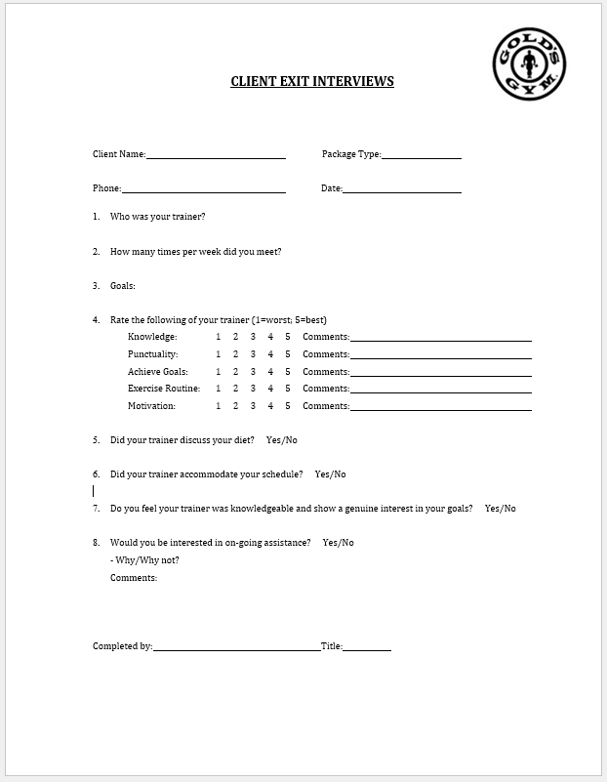
OUR SERVICE: EXIT INTERVIEWS
1
OVERVIEW
All clients that do not renew should receive an exit interview.
These should be conducted within 1 week of not renewing.
These are completed by management (Not the personal trainer).
Interviews should be stored in client folders.
2
HOW TO CONDUCT
Exit interviews can be done over the phone or in person.
Let the client know that you would like feedback about their time with your PT.
These questions should be conversational, not a checklist. Their honest feedback is important to identifying opportunities.
If there are areas the client felt we could have done better, offer the client a corrective solution (Example: Trainer didn’t accommodate schedule, offer a comp session at the clients desired time with a new trainer).

Slide 80
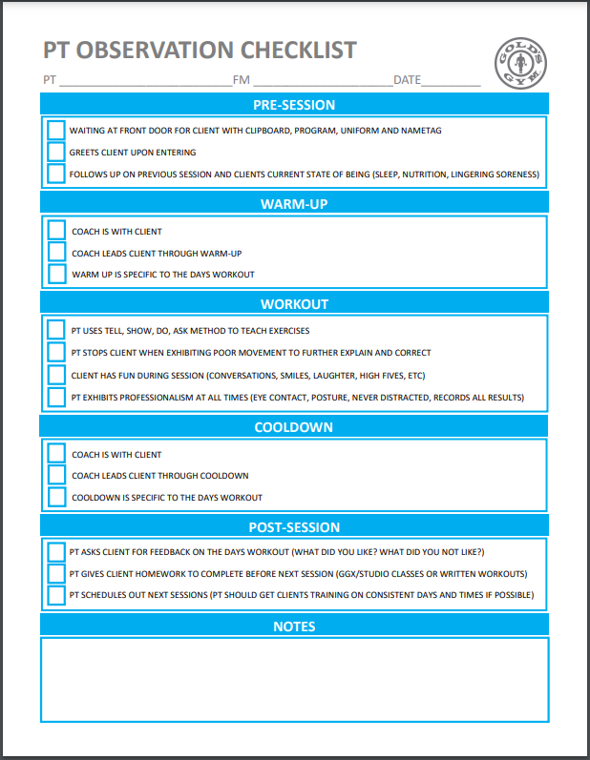
OUR SERVICE: SESSION OBSERVATIONS
1
OVERVIEW
Session observations should be conducted weekly.
Attention should be paid to clients that have not committed to renewing (Is there a service quality opportunity).
Observations should be stored in PT development binder.
Session observations should be discussed during PT 1 on 1s.
2
HOW TO CONDUCT
Schedule the observation with PT PRIOR to the session date.
Introduce yourself to the client (if not already known).
Inform the client “as the leader of fitness for the gym, you would like to observe their session today to ensure we continue to provide the best possible service”.
Ensure the client is comfortable with the observation (ask them if they mind?)
Observe but not participate, any observations or corrections made should be discussed outside of client's presence.

Slide 81
OUR PEOPLE
^
FITNESS

Slide 82
OUR PEOPLE: PT 1 ON 1’S
1
PT Business Plan Review
Highlight renewal opportunities and with clear understanding of who/when/what clients will be renewing.
Outline any clients not listed vs active client report (Inactive clients, non renewed clients, ETC.)
Discuss client frequency (listed frequency vs actual frequency) Are we making up missed sessions?
Discuss established goal metrics (Sessions serviced, active clients, Set/show/close rate) and how to achieve these goals.
Discuss any discrepancies found in client file audit and establish corrective actions or improvements.
2
Session Observation Notes
Discuss session observation notes with PT. What was done well, what opportunities are there.
Establish follow up schedule and go do’s for outlined opportunities.
3
Development Training
Role play with PT based on their specific opportunities. (Client renewal conversations, CPTS closing, ETC.)
Evaluate client prospecting plan and provide adjustments where needed.
Provide feedback on client programming (are clients reaching their goals, what alternatives could support?)

Slide 83
OUR PEOPLE: PT GOAL SETTING
Building a PT’s business starts with understanding what they want to achieve. Once this is outlined, you can identify actions with milestones to reach these goals.
PT BUSINESS NEEDS
PT’s desired coaching capacity? Example: 35 Sessions Per week
How many sessions is PT currently training? Example: 18 Sessions Per week
How many client does Pt currently Have? Example: 9 Active clients
What is the PT’s current client frequency? Example: 2 Sessions Per week
How many new clients will the PT need? Example: 9 Clients
Desired Sessions
35
Current Sessions
18
Current Clients
9
Current Sessions
18
Sessions Needed
17
Frequency
2 x Per WK
Current Clients
9
New Clients
9
Sessions Needed
17
Frequency
2 x Per WK
New Clients Needed
9
Total Clients Needed
18
Now that we have our long-term business goals, we need to understand how to reach them over time.

Slide 84
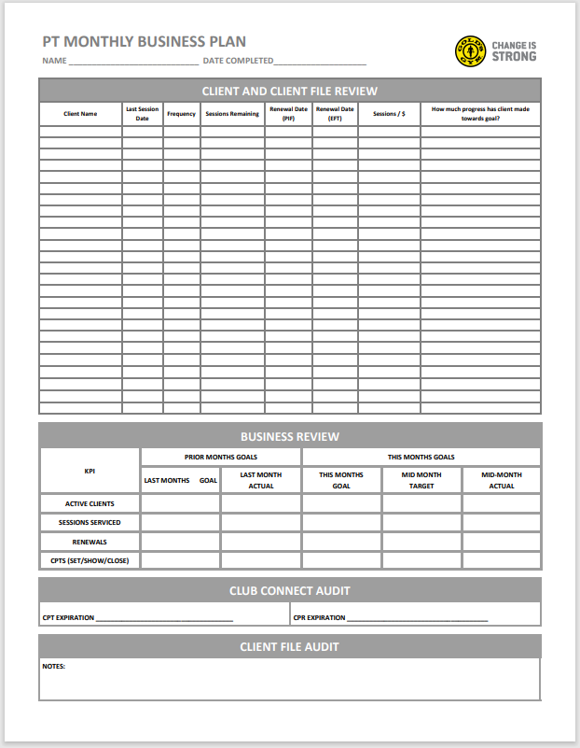
OUR PEOPLE: PT BUSINESS PLANS
1
CLIENT AND CLIENT FILE REVIEW
All PT’s complete at the beginning of the month.
Manager reviews clients and compare to active client report for missed opportunities (Inactive clients).
Log client renewals for weekly run rates.
Compare PT listed client frequency to actual frequency in active client report.
2
BUSINESS REVIEW
Completed by manager after PT completes client information.
Set monthly goals based on previous months performance, club needs and PTs committed growth availability.
Manager updates mid month with actual results compared to targets. Make adjustments to PT activities based on results.
3
CLIENT FILE AUDIT
File Audit should be completed during Loss Prevention Assessment.
Files should be assessed for compliance and quality (PAR-Q, Physicians release, ETC.)

Slide 85
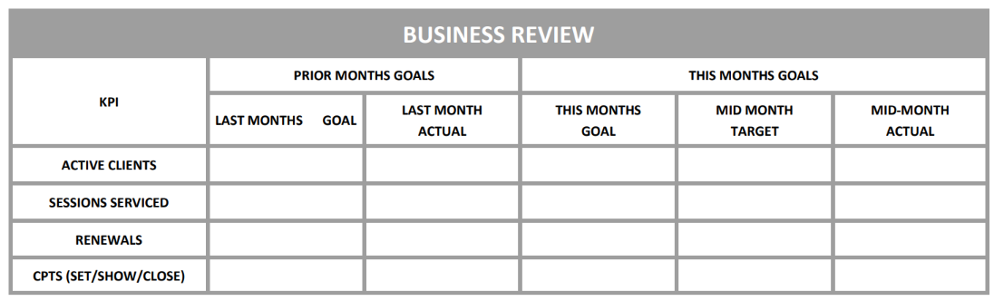
OUR PEOPLE: MONTHLY GOAL SETTING
When setting goals for the current month, you need to review the PT’s prior month performance first. This will allow you to see if there are opportunities in prospecting, sales and renewals and project realistic end of month growth.
Baseline
Why
Learned
Goal setting considerations
0% Attrition accounted for
Frequency is higher than actual.
More focus needed on renewal
Increase prospecting or closing
Clients at start of month: 9
Clients at end of month: 9
No growth
CPTS: Need an increased focus on setting
Renewals: Attrition is 20%, this needs factored in
Sessions Serviced: Frequency Avg in 1.7 not 2 as projected
Active Clients: Clients + CPTS Closed - Attrition = Total clients
12
9
11
10
90
61
80
44
9
7
8
5
12/10/4
10/7/2
12/9/3
7/4/2

Slide 86
OUR PRODUCT: RENEWALS
PT client renewals make up the majority of our fitness business and needs a proportional amount of focus. Renewing clients should not be guess work, we should understand what our renewals look like and set standards for how they are conducted.
COMMON PRACTICE
BEST PRACTICE
Only manage renewals that PT’s list as renewals.
PT’s wait until the last session to ask if client would like to continue training
Ask if the client wants to keep doing what they are doing while finishing their session.
Assume client did not continue training due to financial reason (most frequently reported reason by PT’s).
Manage renewals through the active client report.
PT’s should have renewal conversations at least 3 sessions before needing to renew.
Presenting renewal clients with an updated training plan based on progress charts, frequency needs and goal forecasting.
Conduct exit interviews for non renewed clients. They have fitness goals, can we still help them achieve them?
***PT client’s continue training if they see value in the service. Sometimes it can be cost prohibitive, but there can be a service need not being met, managing renewals with our PT’s ensures we fulfill client expectations.

Slide 87
OUR PRODUCT: RENEWAL MANAGEMENT
Identify renewal
Establish action plan
Present renewal
Client renews
Client does not renew
PT completes business plan with renewals
Discusses renewals with PT
PT discusses renewals 3 sessions out
Schedule next 2 weeks sessions
Manager conducts exit interview
Manager reviews active client report for missed renewals
Plan outlines duration and goals for continued training
PT presents how many sessions and frequency needed
Maintain client frequency (make up missed sessions)
Identify opportunities and
Reengage client in PT

Slide 88
OUR PEOPLE: PROSPECTING
Prospecting is communication with the long-term intent of gaining a new client. For most prospecting to result in a client, it can require a series of conversations, referred to as layering.
1ST CONTACT
2nd CONTACT
3rd CONTACT
4th CONTACT
Pleasant greeting
Warm introduction
Get to know members goals, offer pointers
Present a solution CPTS or PT
Two types of prospecting
External
Speaking to members and non-members outside of the club
Phone calls ( New member calls, inactive client list, missed opportunity follow ups)
outreach events
Client referral communication (Email, text, calls)
Internal
Speaking to members inside the club
At the front desk
racking weights
waking past members on the floor
Scheduled activities (Body fat table, PT instruction seminars, Fitness contests)

Slide 89
OUR PEOPLE: CPTS MANAGEMENT
The CPTS is the first opportunity we have to demonstrate our fitness offerings. This should be a smooth process that encourages our members to let our PT’s help them reach their fitness goals.
SET
CONFIRM
CONDUCT
CONVERT
SCHEDULE
FOLLOW UP
Follow up with non clients to reassess their performance.
Make a follow up recommendation .
Set within 3 days.
Inform client who their trainer is.
Communicate to trainer the client's goals.
24 hours prior, the trainer confirms the session.
Understand what the client wants to get out of the session.
Present a program that achieves the client's goals.
Provide the plan they need, not what we think they can afford.
Close the sale.
Schedule clients first session within 3 days of purchase.
If no purchase, schedule a follow up for 30 days later.
Complete questionnaires (don’t hand to client to fill out).
Complete assessments.
Provide preprogrammed workout.

Slide 90
OUR PEOPLE: BUILDING A BUSINESS
Effective management of prospecting and CPTS’s will make our fitness business grow.
By improving your Set, Show and Closing by only 10%, you need 100 less appointment shows, 191 less Sets and 1192 less contacts made to gain 20 clients. Focusing on quality over quantity gives you a significant return on your investment.
20 clients needed
20 clients needed
Contacted
1665 Contacts
Contacted
473 Contacts
+ 10 %
20 % Set
333 Scheduled
30 % Set
142 Scheduled
60 % Show
200 Shows
70 % Show
100 Shows
10 % Closing
20 Closes
20 % Closing
20 Closes
Based on 12 - 16 weeks
Based on 12 - 16 weeks

Slide 91
OUR PEOPLE: CLIENT FREQUENCY
Training frequency is a critical component for clients to achieve their goals and for Gold’s to have a strong fitness business.
1
Low frequency clients have a higher attrition rate. The cause for this can have multiple factors, What are they?
Perceived service value
Low training frequency produces less results, clients will often only workout when they are scheduled with a trainer. One session a week will most likely not produce the results clients are looking for.
Infrequent sessions lead to lack of motivation. With minimal guidance and encouragement, client's motivation can diminish over time.
2
Most of our clients do not train as often as they have committed to, or how much we think they do. Why is that?
Session Accountability
On average 10% of our clients will cancel their session before the service date. This increase to 20% during holidays and community events.
PT’s should be rescheduling these “make up sessions” before their next regularly scheduled session.
Selling small introduction packages with the intent of increasing frequency on the resign (Rare occurrence).

Slide 92
OUR PEOPLE: IMPACT OF FREQUENCY
Having a balanced training frequency provides PT’s a manageable client load while still hitting their financial targets.
Weekly Frequency
Train 15 Sessions Weekly
Train 25 Sessions Weekly
Train 35 Sessions Weekly
PT benefits of consistent frequency
0.5 Session
30 Clients Needed
50 Clients Needed
70 Clients Needed
MORE PAY FOR LESS WORK
Fewer clients to program for
Fewer resign conversations
Greater client retention
Fewer prospecting hours needed to replace clients
1 session
15 Clients Needed
25 Clients Needed
35 Clients Needed
1.5 Sessions
10 Clients Needed
17 Clients Needed
24 Clients Needed
2 Sessions
8 Clients Needed
13 Clients Needed
18 Clients Needed
Gym benefits of consistent frequency
2.5 Sessions
6 Clients Needed
10 Clients Needed
14 Clients Needed
Simplifies renewal management
Less prospecting payroll
Less programming hours paid
3 Sessions
5 Clients Needed
9 Clients Needed
12 Clients Needed
This is where you will start to find the most stability in your fitness business.

Slide 93
STRONG
R&C OPERATING MODEL

Slide 94
OUR EXPERIENCES
^
R&C

Slide 95


OUR EXPERIENCES-The 3 S’s
Sales
Engaging members and increasing conversion though product and promotion knowledge, sampling, and suggestive selling
Stock
Managing all aspects of your inventory- shipments, stock room, POG, pro shop standards
Support
Assisting members while shopping and at front desk

Slide 96
OUR PROCESSES
^
R&C

Slide 97
OUR PROCESSES: DAILY
1
2
3
4
FDA R&C Huddle
Review Shift Goals x4 per day at shift changes and midpoints
Sampling
Changes monthly as directed by Support Team
Product Merchandising
Restock, clean, process shipments, and organize as needed- min 2x per day
Support
Engage and support members as they check-in and shop
WHY WE DO THIS
Our daily processes are the actionable items that lead all production results.

Slide 98
OUR PROCESSES: WEEKLY
1
2
3
4
Full POG Review
Review Pro Shop versus most recent POG
Track Sales
Check transactions of high value items missing from POG
Low Stock Reporting
Alert R&C team to any products that are selling out before replenishment.
Retail Supply Check
Check supply level of essential retail items (price gun, sale stickers, hangers)
WHY WE DO THIS
Our weekly processes support consistent product placement and ensure all product is merchandised correctly to lead our team to success.

Slide 99
OUR PROCESSES: MONTHLY
1
2
3
4
5
R&C Action Plan
Support staff will publish a monthly action plan to be shared with the team and housed at FD
Inventory/Full Cycle Count
Managers complete full count of inventory to ensure proper replen and reporting to Finance
Review Variance Report
Following inventory, managers must review monthly variances to ensure accurate reporting
Promotions Review
Rotate out expired promotions and install new promo materials (if applicable)
POG Refresh
Check for updated POG and reset planogram if necessary
WHY WE DO THIS
Our monthly processes create a clear plan of action for the club's success and allow all team members to align with current initiatives without compromising standards.

Slide 100
OUR PROCESSES: QUARTERLY
1
2
Retail Audit
Full retail audit with scoring of your pro shop performed by R&C Team
Strategy Review/Discussion
Actionable items and strategy discussion between managers and R&C team
WHY WE DO THIS
Our quarterly audit and strategy review provides a chance to ensure standards are being met while identifying areas of growth and improvement in the future.

Slide 101
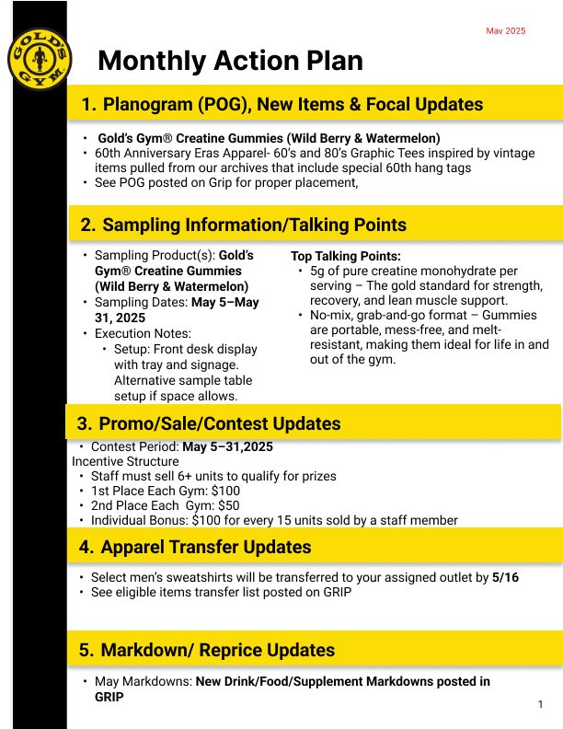
OUR PROCESSES: R&C Monthly Action Plan
To provide a standardized member experience, the support team will publish a one page guide each month.
1
OVERVIEW
Action plan highlighting new product with suggestive selling tips, promotions/deals, and sampling outline
Managers should print and laminate (using Staples/Amazon laminating sheets)
Store at the FD along with Shift Goals and Cooler POG
2
REVIEW
Awareness of new product launches and product highlights
Understand promotions (+ contests) and how to correctly ring up in MOSO
Understanding sampling guidelines and supplies needed- will also send sampling tool checklist 1 week before the new month to ensure compliance
Correctly merchandise new products and execute sale and/or promotional tables when directed.

Slide 102
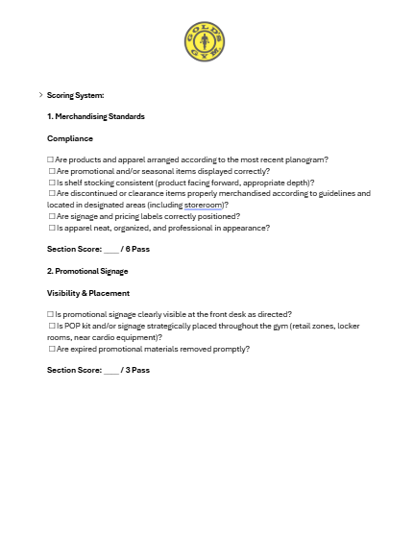
OUR PROCESSES: Quarterly R&C Audit
This new pass/fail audit will be performed quarterly buy our retail field merchandiser highlighting areas of strength and areas needing improvement.
1
OVERVIEW
Scheduled quarterly and separate from Operations Audit
Pass/Fail needing 80% to pass
Designed to improve your retail functions and celebrate your successes
2
REVIEW
Focused on 5 main areas of your pro shop
Merchandising
Signage/POP
Stock Room and Inventory Management
Customer Service/Member Engagement
Systems Knowledge (MOSO & Clearspider)

Slide 103
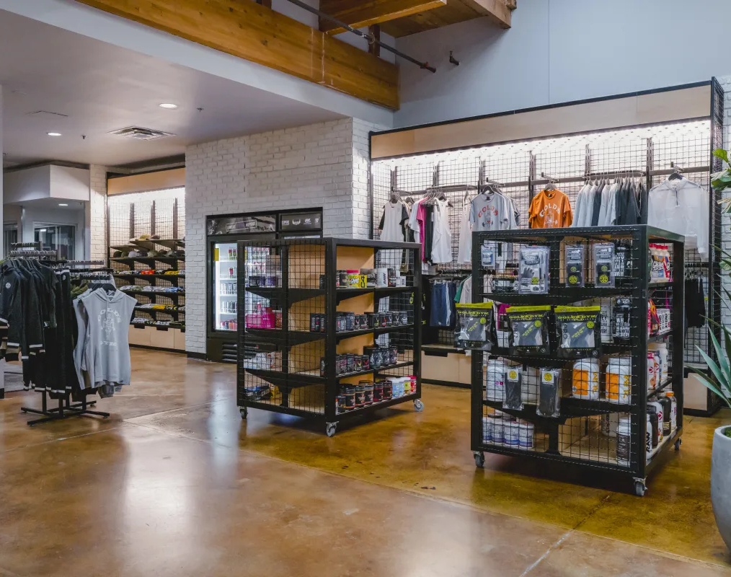
OUR PROCESSES: Inventory Count & Reconciliation Procedure
1
OVERVIEW
Performed once a month
Dates provided by R&C team and listed on GRIP
Accommodations can be made with approval of R&C team
Provides a report of all items currently in your gym
Inventory Count and Reconciliation Procedure must be executed on the same day
The Inventory Count is the count of all apparel, bars, snacks, drinks, and supplements in your gym
The Reconciliation Procedure allows you to correct counting mistakes and double check any losses and gains

Slide 104

OUR PROCESSES: Inventory Count Best Practices
BEST PRACTICES
Charge your inventory scanner the day before performing inventory
The earlier in the day you upload inventory the more accurate it will be
Keep your storeroom organized to ensure products are not missed during scanning
Start the inventory count process in your storeroom and then lock until inventory is complete and uploaded
Any restocking done during inventory will result in inaccurate reporting
Items with missing UPCs should be manually added into your report and retagged prior to the next inventory
Any scanning or upload issues should be brought to the attention of the R&C Team ASAP
Example: College Station

Slide 105


OUR PROCESSES: RECONCILIATION BEST PRACTICES
1
Copy and Paste the report from ClearSpider to Excel to save a copy (email to R&C team once reviewed)
BEST PRACTICES
Reconciliation Procedure/reviewing your Variance Report is an essential party of the inventory procedure
If the value of the items for any category is positive this is a concern
If items from an open PO(see My To Do List on ClearSpider) are positive in similar quantities as those on order, this is a concern
If entire cases of drinks or food shrink out this may indicate these were either missed or received incorrectly
2
Use cycle count function to fix counting errors
Notes:
If entire cases of drinks or food shrink out this may indicate these were either missed or received incorrectly

Slide 106



OUR PROCESSES: READING AND RECEIVING INVOICES
1
OVERVIEW
As you receive deliveries use the invoice as worksheet to record quantities, out of stock (OOS) and, missing or damaged items
DO NOT receive orders in ClearSpider without an Invoice
Reach out to R&C team to obtain a copy
2
IDENTIFYING DIFFERENT SCENARIOS
Example Invoice

Slide 107




OUR PROCESSES: RECEIVING INVOICES PROCESS
1
Using the Invoice Number find corresponding order in ClearSpider
3
Enter invoice number into “Package Tracking” field
2
Using Invoice, correctly receive items marking any OOS or Damaged units appropriately
4
Reach out to R&C team for advice/credit on Short Shipped items
Example Credit Request Email
Notes:
If entire cases of drinks or food shrink out this may indicate these were either missed or received incorrectly

Slide 108
OUR MEMBERS
^
R&C

Slide 109


OUR MEMBERS: MEMBERS SHOPPING EXPERIENCE
2
Drinks, bars, snacks, and supplements should be stocked, front facing, and dust free
1
Apparel should be merchandised and organized just like any other retail stores
Ensure products are properly stocked and front facing
Refresh POG throughout the day as members browse and make purchases
Apparel should be neatly hung or folded based on size (smallest to largest)

Slide 110



OUR MEMBERS: MEMBERS SHOPPING EXPERIENCE
Follow POG to ensure a clean display and avoid empty shelves
4
Frequently check POG for Expiring/Expired/Damaged Products
3
Example: Protein Powders damaged by the sun (Members should not be purchasing products that are damaged or expired)
Empty or improperly stocked shelves can interfere with shopping and discourage purchases

Slide 111
OUR PRODUCT
^
R&C

Slide 112
OUR PRODUCT: POG, ClearSpider, and Merchandising SOPs (GRIP)
Providing a great experience doesn’t end with the workouts we provide. How we display and mange our product is part of this experience. “Converting” should be focused on the product and deals and how they benefits our members.
POG/Planogram
1
Visual diagram, updated monthly to assist with Pro Shop setup and management
ClearSpider
SOPs
2
SOPs on different functions in ClearSpider, an inventory management tool
Merchandising Standards Guide
3
Current SOP outlining standards and supplies to present a beautiful and organized pro shop
Promo SOP
New SOP demonstrating how to consistently display promotions and the supplies needed
4
Sale/Discontinued Item SOP
5
New SOP demonstrating how to consistently display sale and the supplies needed
Sampling SOP
6
New SOP outlining how to prepare and execute a healthy and productive sampling event

Slide 113

OUR PRODUCT: POG/PLANOGRAM
Providing a great experience doesn’t end with the workouts we provide. How we display and manage our product is part of this experience. “Converting” should be focused on the product and deals and how they benefits our members.
Visual guide to setting up Pro Shop bars, snacks, and supplements. *Updated Monthly*
1
OVERVIEW
POG/Planogram
1
The POG is a visual tool to aid with restocking and setting up your pro shop
Every apparel item, bar, snack, supplement, and RTD has a designated spot on the POG.
Designed to: Enhance Product Visibility, Improve Member Experience, and Optimize Available Space
2
REVIEW
Check the updated POG at the beginning of the month to ensure new items are added to your pro shop and discontinued items are moved to the designated shelves.
Missing items on the shelves and walls in your pro shop can be used to assist you in inventory management
Use the holes to track sales, replen problems, and potential theft
Example: May 2025

Slide 114

OUR PRODUCT: ClearSpider SOPs
Providing a great experience doesn’t end with the workouts we provide. How we display and manage our product is part of this experience. “Converting” should be focused on the product and deals and how they benefits our members.
Guides to key functions in ClearSpider (receiving, performing inventory, etc.) An inventory management tool.
2
ClearSpider SOPs
1
OVERVIEW
SOPs to assist in utilizing ClearSpider for successful inventory management
Reading Invoices and Receiving Procedures (example)
Change on-hand Count (Cycle Count, Damaged/Expired Items)
Inventory Procedure
2
REVIEW
Utilize these SOPs to improve your inventory management and reporting accuracy
Cover unique situations such as incorrect products, quantities, or damaged items received in a shipment
Example: Reading Invoices and Receiving Procedures

Slide 115

OUR PRODUCT: MERCHANDISING STANDARDS
Providing a great experience doesn’t end with the workouts we provide. How we display and manage our product is part of this experience. “Converting” should be focused on the product and deals and how they benefits our members.
Visual guide to setting up and managing apparel in your Pro Shop
Merchandising
Standards Guide
OVERVIEW
3
1
Provides visual guidelines for a streamlined shopping experience for members when shopping in your pro shop
2
REVIEW
Guidance on tasks such as tagging, folding, and hanging different types of apparel
Provides resources for replacements for Pro Shop essentials:
Shelving Units, Hangers, Price Gun, Clothing Tags, Security Magnets, etc.
Use to reduce pain points during members shopping experience and increase revenue in your gym

Slide 116

OUR PRODUCT: PROMOTIONAL SOP
Providing a great experience doesn’t end with the workouts we provide. How we display and manage our product is part of this experience. “Converting” should be focused on the product and deals and how they benefits our members.
Guide to running in gym promotions initiated by the R&C team.
Promo SOP
1
OVERVIEW
4
Resource for executing different types of in gym promotions
Provides a detailed guide on roles and responsibilities and best practices
2
REVIEW
Utilize best practices for increased success when running promotions in your gym
Set daily staff engagement expectations with your FDAs to maximize member engagement
Implement the daily and weekly tasks suggested to drive sales throughout the month

Slide 117

OUR PRODUCT: SALE/DISCONTIUED ITEM SOP
Providing a great experience doesn’t end with the workouts we provide. How we display and manage our product is part of this experience. “Converting” should be focused on the product and deals and how they benefits our members.
Guide to managing discontinued/expiring bars, snacks, and supplements.
Sale/Discontinued Item
OVERVIEW
5
1
Guide on managing discontinued/sale items in your Pro Shop
Assists with the sale of items listed on the Markdown List (Updated monthly by R&C team) and reduces inventory overflow
2
REVIEW
Utilize discounted pricing, sale stickers, and flex sale displays to drive sales and reduce loss through product expiration
A 65% Expiring Product Discount can be applied to products within 45 days of expiration

Slide 118

OUR PRODUCT: SAMPLING SOP
Providing a great experience doesn’t end with the workouts we provide. How we display and manage our product is part of this experience. “Converting” should be focused on the product and deals and how they benefits our members.
Guide to executing in gym samplings of supplements, bars, snacks, and RTD drinks.
Sampling SOP
1
OVERVIEW
6
In gym samplings (organized by the R&C Team) can be used to increase sales and improve member engagement
SOP provides guidance for the execution of selective sampling for different products
Specific product sampling instructions will be provided to gyms to assist with member engagement during samplings
2
REVIEW
Print out talking points for FDAs to increase conversion rate
Identify the sampling set up that best fits your gym layout
Ensure sampling does not interfere with day-to-day operations or members experience

Slide 119
OUR SERVICE
^
R&C

Slide 120
OUR SERVICE PROMISE
Key Service Principles
Engage with Excitement:
Engage with members as they shop and make purchases. Shopping the Pro Shop should be a positive experience.
Merchandise with Purpose
Keep displays clean, organized, and visually appealing to encourage browsing and impulse buys.
Be Approachable & Proactive
Greet members near retail zones, ask if they need any help
Support the Member Journey
Position products in Pro Shops as tools for success, help members connect purchases to performance and recovery.
Drive Value, Not Just Sales
Utilize promotions, samplings, and ensure members feel they’re getting more than just a transaction.
Our Objective:
To deliver a high-impact retail experience that supports member goals, drives sales, and reinforces the Gold’s Gym brand.

Slide 121
OUR PEOPLE
^
R&C

Slide 122

OUR PROCESSES: FDA R&C Shift Huddle
Setting shift goals with the front desk team is equally as important as every other part of our business. Our font desk team members are the front-line promoters of our R&C. Huddling up to discuss results and opportunities is a allows every member on our team to help dive our business.
1
OVERVIEW
2 Min meeting with FDA- 4x per day at shift change and mid shift
Goal worksheet must be filled in each morning using Power BI and Simple math
Laminate with Monthly Action Plan to store at FD and use dry erase markers
2
REVIEW
Daily Shift Goals and progress with FDAs
Review/Remind opportunities to increase conversion through suggestive selling, sampling, and promotions
Nothing should feel forced, remember this is all about member engagement and natural conversations

Slide 123

OUR BRAND IS STRONG WHEN WE FOCUS ON OUR EXPERIENCE, PROCESSES, MEMBERS, PRODUCT, SERVICE, & PEOPLE.

